Slide 1
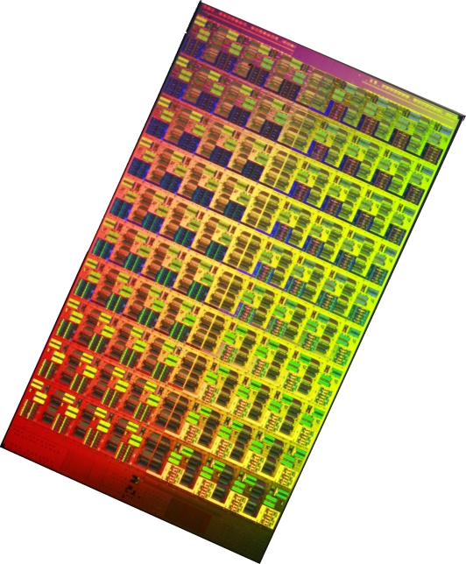
Network-on-Chip
(2/2)
Ben Abdallah Abderazek
The University of Aizu
E-mail: benab@u-aizu.ac.jp
Hong Kong University of Science and Technology, March 2013

Slide 2
Part II: NoC Building Blocks
Topology
Routing Algorithms
Routing Mechanisms
Switching
Flow Control
Router Architecture
Network Interface

Slide 3
Part II: NoC Building Blocks
Topology
Routing Algorithms
Routing Mechanisms
Switching
Flow Control
Router Architecture
Network Interface

Slide 4
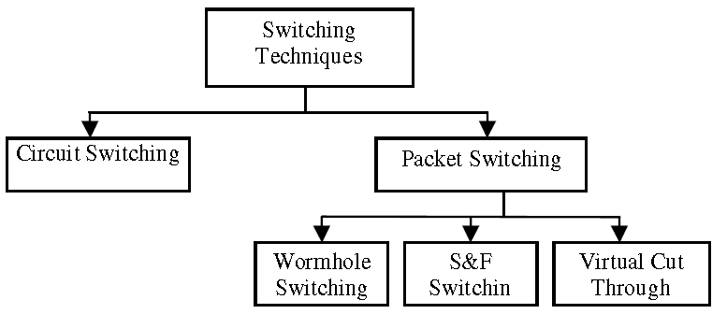
NoC Switching
Switching techniques define the way and time of connections between input and output ports inside a switch.
Circuit switched networks reserve a physical path before transmitting the data packets
Packet switched networks transmit the packets without reserving the entire path.

Slide 5
Circuit Switching
All resources (from source to destination) are allocated to the message prior to transport
  Probe sent into network to reserve resources
Once probe sets up circuit
  Message does not need to perform any routing or allocation at each network hop
  Good for transferring large amounts of data
    Can amortize circuit setup cost by sending data with very low per-hop overheads
No other message can use those resources until transfer is complete
  Throughput can suffer due setup and hold time for circuits

Slide 6
Circuit Switching
Header Probe
Acknowledgment
Data
t_{s}
Link
t_{r}
t_{s}
t_{setup}
t_{data}
Time Busy
Hardware path setup by a routing header or probe
End-to-end acknowledgment initiates transfer at full hardware bandwidth

Slide 7
Circuit Switching Example
0
Configuration Probe
5
Data
Circuit
Acknowledgement
Significant latency overhead prior to data transfer
Other requests forced to wait for resources

Slide 8
Circuit Switching Delay
  T = 3 H tr + L/b
H : time required to set up the channel and delivers the head flit
tr: serialization latency
L: time of flight
b: contention time
Note: 3 x header latency because the path from source to destination must be traversed 3 times to deliver the packet: Once in each direction to set up the circuit and then again to deliver the first flit

Slide 9
Store & Forward Switching
Intermediate nodes
Destination node
Source node
Each node along a route waits until a packet is completely received (stored) and then the packet is forwarded to the next node
Two resources are needed
  Packet-sized buffer in the switch
  Exclusive use of the outgoing channel

Slide 10
Store & Forward Switching
S&F switching forwards a packet only when there is enough space available in the receiving buffer to hold the entire packet.
Thus, there is no need for dividing a packet into flits. This reduces the overhead, as it does not require circuits such as a flit builder, a flit decoder, a flit stripper and a flit sequencer.
Nevertheless, such a switching technique requires a large amount of buffer space at each node. Thus, it may not be a feasible solution for embedded applications

Slide 11
Store & Forward Switching Example
High per-hop latency
Larger buffering required

Slide 12
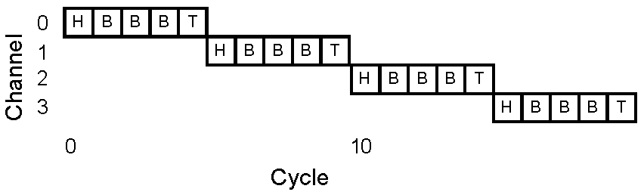
Store & Forward Switching
Advantage
  While waiting to acquire resources, no channels are being held idle
Disadvantage
  Requires a large amount of buffer space at each node
  Very high latency

Slide 13
Store & Forward Switching
Finer grained sharing of the link bandwidth
Routing, arbitration, switching overheads experienced for each packet
Increased storage requirements at the nodes
Packetization and in-order delivery requirements
Alternative buffering schemes
  Use of local processor memory
  Central (to the switch) queues

Slide 14
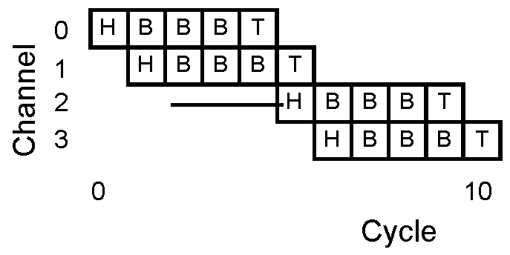
Virtual Cut-through Switching
Transmission on the next channel starts directly when the new header flit is received
Channel is released after tail flit

Slide 15
Virtual Cut-through Switching
Transmission on the next channel starts directly when the new header flit is received
Channel is released after tail flit

Slide 16
Virtual Cut-through Switching
Transmission on the next channel starts directly when the new header flit is received
Channel is released after tail flit

Slide 17
Virtual Cut-through Switching
Transmission on the next channel starts directly when the new header flit is received
Channel is released after tail flit

Slide 18
Virtual Cut-through Switching
Packet-based: similar to Store and Forward
Links and Buffers allocated to entire packets
Flits can proceed to next hop before tail flit has been received by current router
  But only if next router has enough buffer space for entire packet
Reduces the latency significantly compared to SAF
But still requires large buffers
  Unsuitable for on-chip

Slide 19
Virtual Cut-through Switching
Packet Header
Message Packet
cuts through
the Router
t_{w}
Link
t_{blocking}
t_{r}
t_{s}
Time Busy

Slide 20
Virtual Cut-through Switching Example
0
5
Lower per-hop latency
Larger buffering required

Slide 21
Wormhole Switching
Intermediate nodes
Destination node
Source node
Large packets are divided into small flits
An entire packet need not be buffered to move on to the next node, increasing throughput.
More efficient use of buffers than virtual cut-through
Bandwidth and Channel allocation are decoupled

Slide 22
Wormhole Switching
Intermediate nodes
Destination node
Source node
Large packets are divided into small flits
An entire packet need not be buffered to move on to the next node, increasing throughput.
More efficient use of buffers than virtual cut-through
Bandwidth and Channel allocation are decoupled

Slide 23
Wormhole Switching
Intermediate nodes
Destination node
Source node
Large packets are divided into small flits
An entire packet need not be buffered to move on to the next node, increasing throughput.
More efficient use of buffers than virtual cut-through
Bandwidth and Channel allocation are decoupled

Slide 24
Wormhole Switching
Intermediate nodes
Destination node
Source node
Large packets are divided into small flits
An entire packet need not be buffered to move on to the next node, increasing throughput.
More efficient use of buffers than virtual cut-through
Bandwidth and Channel allocation are decoupled

Slide 25
Wormhole Switching
Header Flit
Link
Single Flit
t_{r}
t_{s}
t_{wormhole}
Time Busy
Message are pipelined, but buffer space is on the order of a few flits
Small buffers + message pipelining → small compact switches/routers
Messages cannot be interleaved over a channel: routing information is only associated with the header

Slide 26
Wormhole Example
Red holds this channel: channel remains idle until read proceeds
Channel idle but red packet blocked behind blue
Buffer full: blue cannot proceed
Blocked by other packets
6 flit buffers/input port

Slide 27
Virtual Channel
Virtual channels used to combat HOL block in wormhole
Virtual channels: multiple flit queues per input port
  Share same physical link (channel)
Link utilization improved
  Flits on different VC can pass blocked packet

Slide 28
Virtual Channel Example
Buffer full: blue cannot proceed
Blocked by other packets
6 flit buffers/input port
3 flit buffers/VC

Slide 29
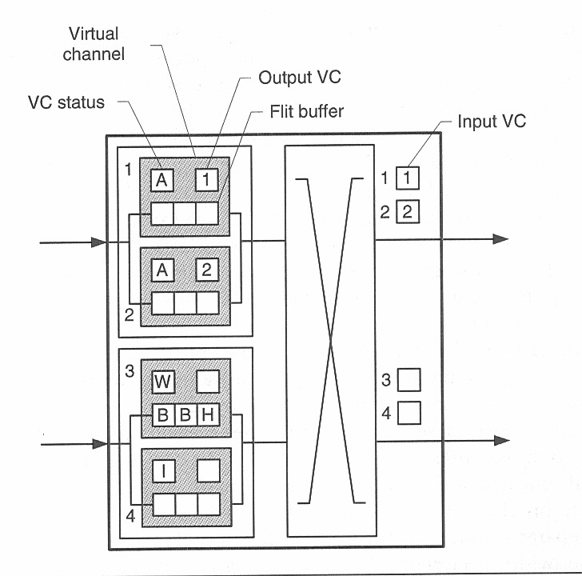
Virtual Channel Example
hold information about which output virtual channel we are attempting to acquire
A: active
W: waiting
I: idle
hold information about which input VC it is reserved by

Slide 30
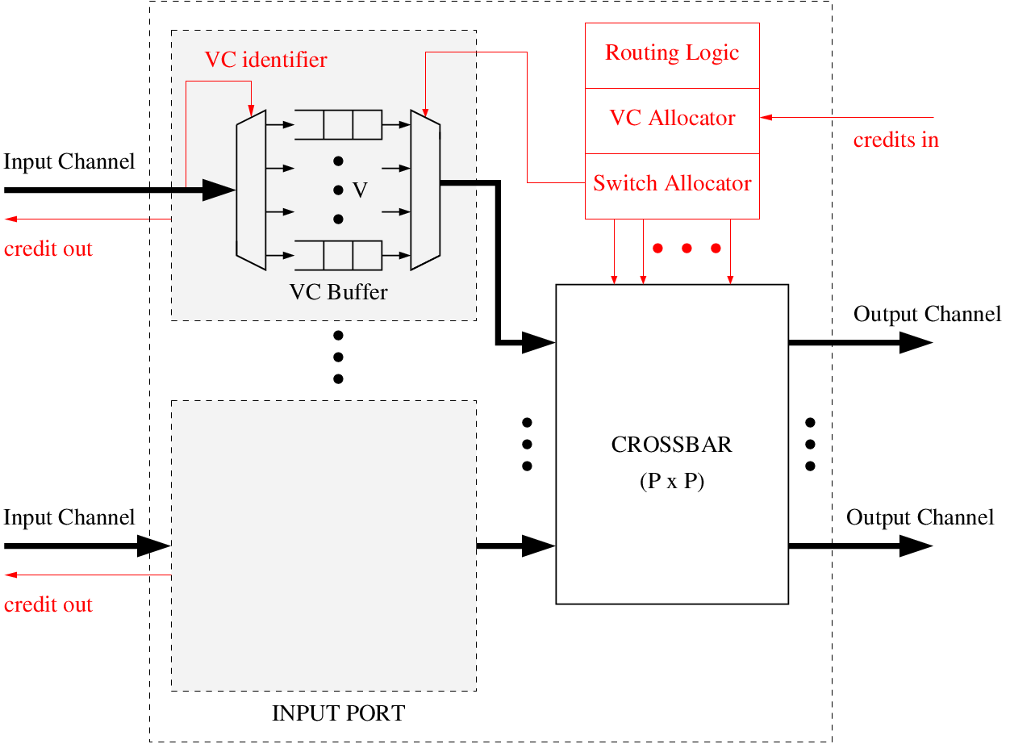
A Virtual Channel Router

Slide 31
A Virtual Channel Router
Every VC of every input port has buffers to hold arriving flits
Arriving flits are placed into the buffers of corresponding VC

Slide 32
A Virtual Channel Router
Every VC of every input port has buffers to hold arriving flits
Routing logic assigns set of outgoing VC on which flit can go
Arbitrates between competing input VC & allocates output VC
Arriving flits are placed into the buffers of corresponding VC

Slide 33
A Virtual Channel Router
Every VC of every input port has buffers to hold arriving flits
Routing logic assigns set of outgoing VC on which flit can go
Arbitrates between competing input VC & allocates output VC
Arriving flits are placed into the buffers of corresponding VC
Matches successful input ports (allocated VC) to output ports
Flits at input VCs getting grants are passed to output VCs

Slide 34
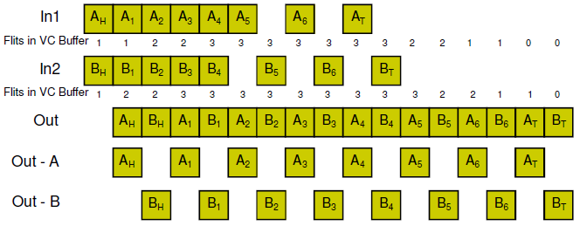
VC Arbitration: Fair Bandwidth
The virtual channels interleave their flits
This results in a high average latency

Slide 35
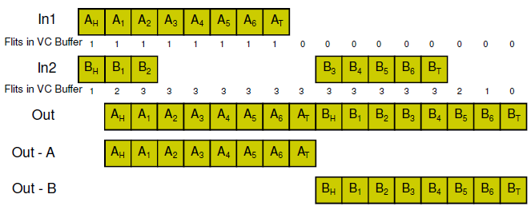
VC Arbitration: Winner-Take-All
A winner-take all arbitration reduces the average latency with no throughput penalty

Slide 36
Virtual Channels
Dest 00
Dest 02
11
12
Dest 01
Dest 01
01
02
Dest 03
Dest 12
Dest 11
Dest 22

Slide 37
Virtual Channels
Dest 00
11
12
Dest 01
Dest 01
Dest 02
Dest 11
01
02
Dest 03
Dest 12
Dest 22

Slide 38
Virtual Channels
Dest 01
11
12
Dest 01
Dest 00
Dest 02
Dest 22
Dest 11
Dest 03
01
02
Dest 12

Slide 39
Virtual Channels
Dest 01
11
12
Dest 01
Dest 02
Dest 11
01
02
Dest 12

Slide 40
Virtual Channels
Dest 01
11
12
Dest 11
Dest 01
Dest 12
Dest 02
01
02

Slide 41
Virtual Channels
11
12
Dest 11
Dest 01
01
02

Slide 42
Summary of Switching Techniques
Switching Technique | Communication Entity | Path Reservation | Buffer Size | Resource Utilization
Circuit Switching | Flit | Yes | Small | Poor
SAF Switching | Packer | No | Large | Good
VCT Switching | Packet | No | Large | Good
Wormhole Switching | Flit | Yes | Small | Moderate
Summary of switching techniques

Slide 43
Break + Qs

Slide 44
Part II: NoC Building Blocks
Topology
Routing Algorithms
Routing Mechanisms
Switching
Flow Control
Router Architecture
Network Interface

Slide 45
Flow Control (FC)
FC determines (1) how resources (Buffers and channel bandwidth) are allocated and (2) how packet collisions over resources are resolved.
Goal is to use resources as efficient as possible to allow a high throughput
A resource collision occurs when a packet P is unable to proceed because some resource it needs is held by another packet.

Slide 46
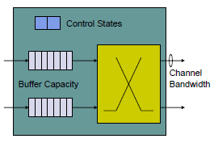
Node Resources
Control State
  Tracks the resources allocated to the packet in the node and the state of the packet
Buffer
  Packet is stored in a buffer before it is send to next node
Bandwidth
  To travel to the next node bandwidth has to be allocated for the packet

Slide 47
Flow Control
NoC Flow Control can be divided into:
Bufferless flow control
  Packets are either dropped or misrouted
Buffered flow control (covered here)
  Packets that cannot be routed via the desired channel are stored in buffers
    Stop-Go,
    ACK/NACK,
    Credit-Based

Slide 48
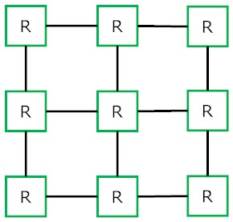

Bufferless flow Control
Flits can’t wait in routers.
Contention is handled by:
  Dropping and retransmitting from the source.
  Deflecting to a free output.
contention
48

Slide 49
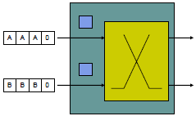
Bufferless Flow Control
No buffers mean less implementation cost
If more than one packet shall be routed to the same output, one has to be
  Misrouted or
  Dropped
Example: 2 packets A and B (consisting of several flits) arrive at a network node

Slide 50
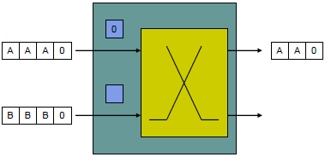
Bufferless Flow Control
Packet B is dropped and must be resended
But, there must be a protocol that informs the sending node that the packet has been dropped
  Example: Resend after no ACK has been received within a given time

Slide 51
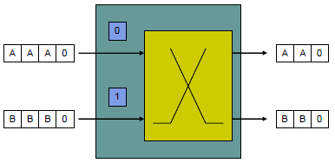
Bufferless Flow Control
Packet B is misrouted
No further action is required here, but at the receiving node packets have to be sorted into original order

Slide 52
Stop-Go Flow Control
Receiver sends Issues a STOP signal when STOP threshold is reached
Sender suspends injecting flits
Sender sends packets whenever GO signal is idle
sender
receiver
X
X
pipelined transfer
GO threshold
STOP threshold
Queue is
not serviced
GO
GO
STOP
STOP
© T.M. Pinkston, J. Duato, with major contributions by J. Filch

Slide 53
Stop-Go Flow Control
Receiver sends Issues a GO signal when GO threshold is reached
Sender resumes injecting flits
Sender suspends sending packets whenever STOP signal is idle
sender
receiver
X
X
pipelined transfer
GO threshold
STOP threshold
Queue is
not serviced
GO
GO
STOP
STOP
© T.M. Pinkston, J. Duato, with major contributions by J. Filch

Slide 54
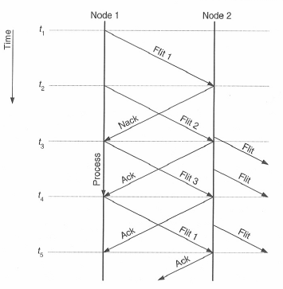
Ack/Nack Flow Control
Upstream node sends packets without knowing, if there are free buffers in the downstream node.

Slide 55
Ack/Nack Flow Control
If there is no buffer available:
  the downstream node sends Nack and drops the flit
  the flit must be resent
  flits must be reordered at the downstream node
If there is a buffer available:
  the downstream node sends Ack and stores the flit in a buffer

Slide 56
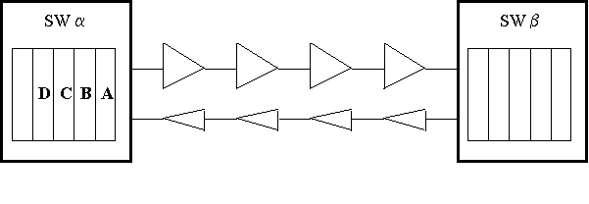
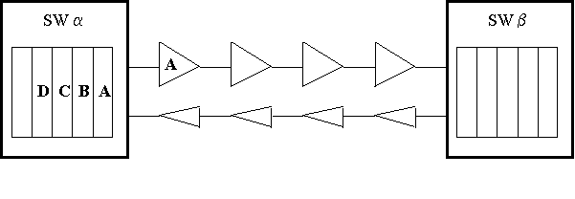
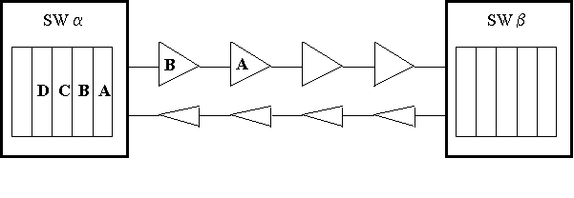
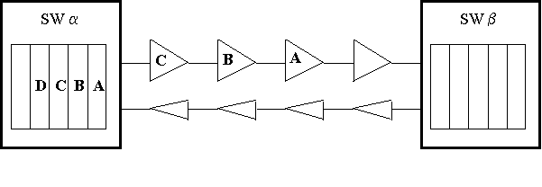
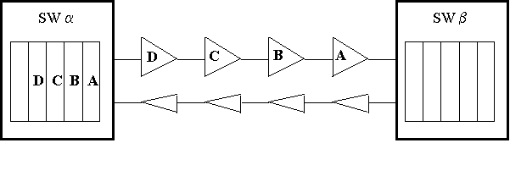
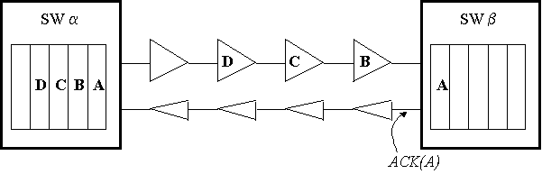
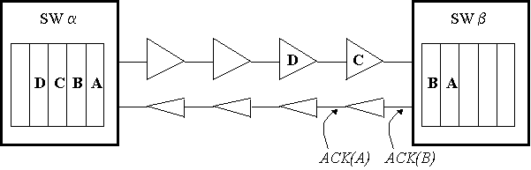
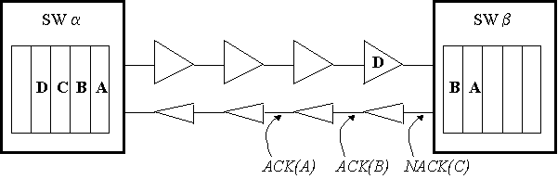
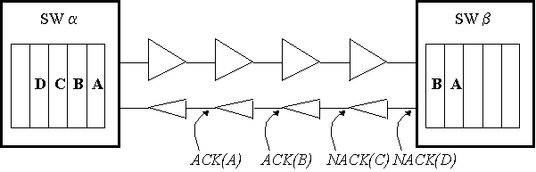
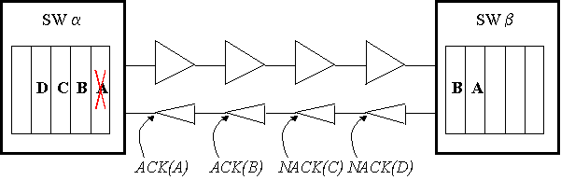
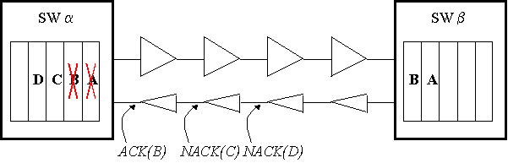
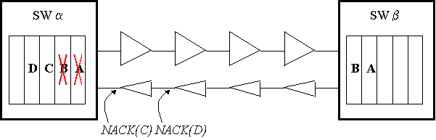
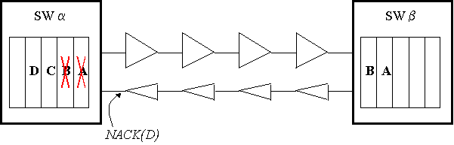
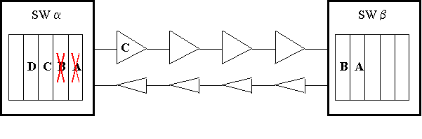
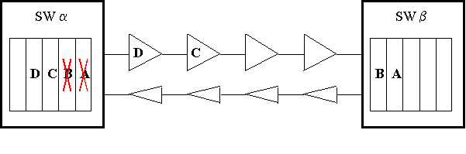
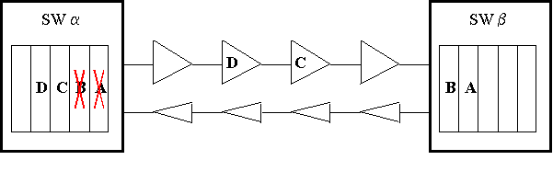
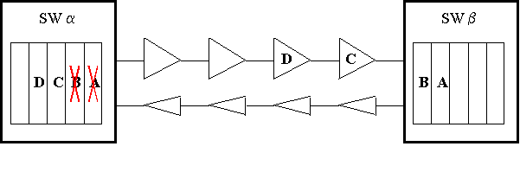
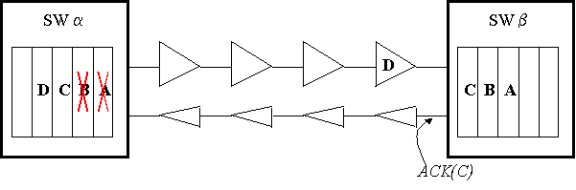
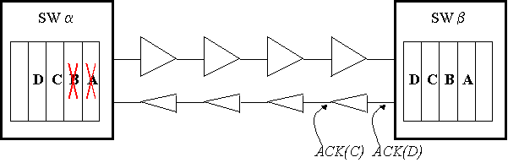
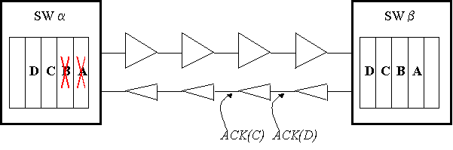
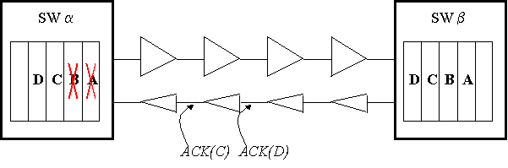
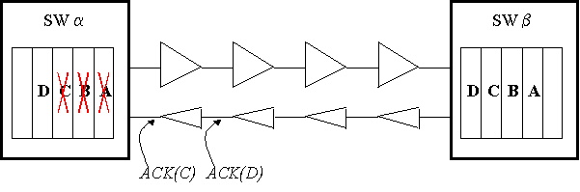
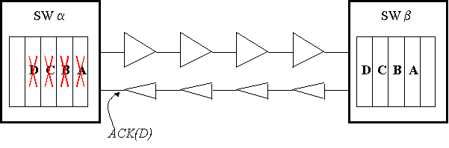
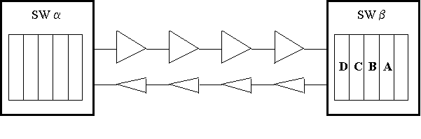
ACK/NACK
Transmission
ACK and buffering
NACK
ACK/NACK propagation
Memory deallocation
Retransmission
Go-back-N

Slide 57
Credit-Based Flow Control
Upstream router stores credit counts for each downstream VC
Upstream router
  When flit forwarded
    Decrement credit count
  Count == 0, buffer full, stop sending
Downstream router
  When flit forwarded and buffer freed
    Send credit to upstream router
    Upstream increments credit count

Slide 58
Credit Timeline
Node 1
Node 2
t1
Credit
Flit departs
router
t2
Process
Credit round trip delay
t3
Credit
Flit
t4
Process
t5
Round-trip credit delay:
  Time between when buffer empties and when next flit can be processed from that buffer entry
  If only single entry buffer, would result in significant throughput degradation
  Important to size buffers to tolerate credit turn-around

Slide 59
Credit-Based Flow Control in action
Sender sends packets whenever credit counter
is not zero
sender
receiver
Credit counter
10
9
8
7
6
5
4
3
2
1
0
X
pipelined transfer
Queue is
not serviced
© T.M. Pinkston, J. Duato, with major contributions by J. Filch

Slide 60
Credit-Based Flow Control in action
Sender resumes
injection
Receiver sends credits after they become available
sender
receiver
Credit counter
10
9
8
7
6
5
4
3
2
5
4
3
2
1
0
X
+5
pipelined transfer
Queue is
not serviced

Slide 61
On-Off (stall-go) Flow Control
Credit: requires upstream signaling for every flit
On-off: decreases upstream signaling
Off signal
  Sent when number of free buffers falls below threshold F_{off}
On signal
  Send when number of free buffers rises above threshold F_{on}

Slide 62
On-Off Timeline
Node 1
Node 2
F_{off}threshold reached
t1
Flit
F_{off}set to prevent flits arriving before t4 from overflowing
t2
Flit
Off
Flit
t3
Flit
Process
t4
Flit
Flit
Flit
Flit
F_{on}threshold reached
t5
Flit
F_{on}set so that Node 2 does not run out of flits between t5 and t8
On
Flit
t6
Flit
Process
t7
Flit
Flit
Flit
t8
Flit
Less signaling but more buffering
  On-chip buffers more expensive than wires

Slide 63
Summary of FC
On-chip networks require techniques with lower buffering requirements
  Wormhole or Virtual Channel flow control
Dropping packets unacceptable in on-chip environment
Complexity of flow control impacts router microarchitecture

Slide 64
Summary of FC
Ack/Nack: is rarely used because of its buffer and bandwidth inefficiency.
Credit-based: Used in systems with small numbers of buffers.
On/Off : Used in systems that have large numbers of flit buffers.

Slide 65
Part II: NoC Building Blocks
Topology
Routing
Switching
Virtual Channels
Flow Control
Router Architecture
Network Interface

Slide 66
Typical Virtual Channel Router
A router functional blocks can be divided into:
Data path: handles storage and movement of a packets payload
    Input buffers , Switch, Output buffers
Control path: coordinating the movements of the packets through the resources of the datapath
    Route Computation, VC Allocator, Switch Allocator

Slide 67
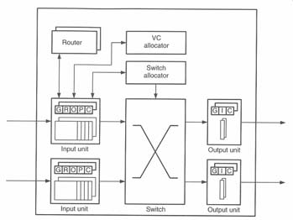
Typical Virtual Channel Router
The input unit contains a set of flit buffers
Maintains the state for each virtual channel
  G = Global State
  R = Route
  O = Output VC
  P = Pointers
  C = Credits

Slide 68
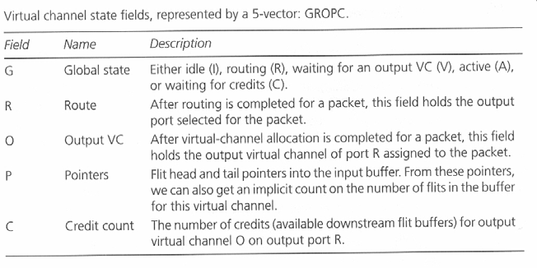
Virtual Channel State Fields
(Input)

Slide 69
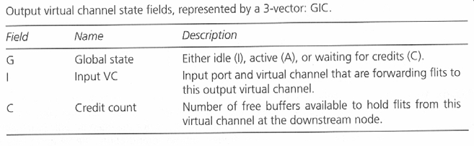
Virtual Channel State Fields
(Output)

Slide 70
Packet Rate and Flit Rate
The control of the router operates at two distinct frequencies
  Packet Rate (performed once per packet)
    Route computation
    Virtual-channel allocation
  Flit Rate (performed once per flit)
    Switch allocation
    Pointer and credit count update

Slide 71
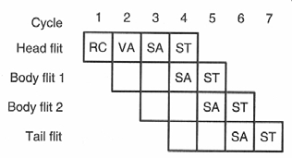
The Router Pipeline
No pipeline stalls

Slide 72
The Router Pipeline
A typical router pipeline includes the following stages:
  RC (Routing Computation)
  VC (Virtual Channel Allocation)
  SA (Switch Allocation)
  ST (Switch Traversal

Slide 73
The Router Pipeline
Cycle 0
  Head flit arrives and the packet is directed to an virtual channel of the input port (G = I)
no pipeline stalls

Slide 74
The Router Pipeline
Cycle 1
  Routing computation
  Virtual channel state changes to routing (G = R)
  Head flit enters RC-stage
  First body flit arrives at router
no pipeline stalls

Slide 75
The Router Pipeline
Cycle 2: Virtual Channel Allocation
  Route field (R) of virtual channel is updated
  Virtual channel state is set to “waiting for output virtual channel” (G = V)
  Head flit enters VA state
  First body flit enters RC stage
  Second body flit arrives at router
no pipeline stalls

Slide 76
The Router Pipeline
Cycle 2: Virtual Channel Allocation
  The result of the routing computation is input to the virtual channel allocator
  If successful, the allocator assigns a single output virtual channel
  The state of the virtual channel is set to active (G = A
no pipeline stalls

Slide 77
The Router Pipeline
Cycle 3: Switch Allocation
  All further processing is done on a flit base
  Head flit enters SA stage
  Any active VA (G = A) that contains buffered flits (indicated by P) and has downstream buffers available (C > 0) bids for a single-flit time slot through the switch from its input VC to the output VC
no pipeline stalls

Slide 78
The Router Pipeline
Cycle 3: Switch Allocation
  If successful, pointer field is updated
  Credit field is decremented
no pipeline stalls

Slide 79
The Router Pipeline
Cycle 4: Switch Traversal
  Head flit traverses the switch
Cycle 5:
  Head flit starts traversing the channel to the next router
no pipeline stalls

Slide 80
The Router Pipeline
Cycle 7:
  Tail traverses the switch
  Output VC set to idle
  Input VC set to idle (G = I), if buffer is empty
  Input VC set to routing (G = R), if another head flit is in the buffer
no pipeline stalls

Slide 81
The Router Pipeline
Only the head flits enter the RC and VC stages
The body and tail flits are stored in the flit buffers until they can enter the SA stage
no pipeline stalls

Slide 82
Pipeline Stalls
Pipeline stalls can be divided into:
Packet stalls
  can occur if the virtual channel cannot advance to its R, V, or A state
Flit stalls
  If a virtual channel is in active state and the flit cannot successfully complete switch allocation due to
      Lack of flit, Lack of credit, Losing arbitration for the switch time slot

Slide 83
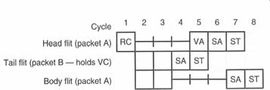
Example for Packet Stall
1. Virtual-channel allocation stall
  Head flit of A can first enter the VA stage when the tail flit of packet B completes switch allocation and releases the virtual channel

Slide 84
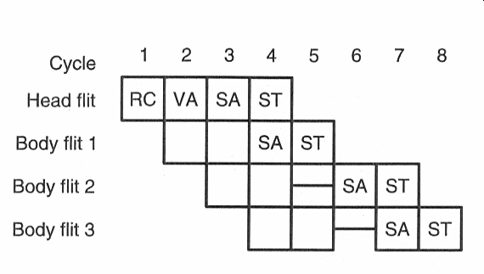
Example for Flit Stalls
2. Switch allocation stall
Second body flit fails to allocate the
requested connection in cycle 5

Slide 85
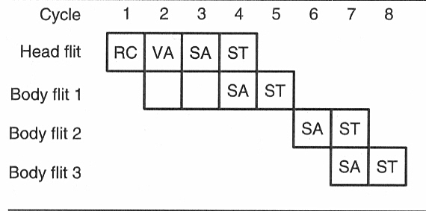
Example for Flit Stalls
3. Buffer empty stall
Body flit 2 is delayed three cycles. However, since it does not have to enter the RC and VA stage the output is only delayed one cycle!

Slide 86
Part II: NoC Building Blocks
Topology
Routing
Switching
Virtual Channels
Flow Control
Router Architecture
Network Interface

Slide 87
Network Interface
Transmitter side
Core
Memory
NI
NI
Router
Router
Notes:
87
87

Slide 88
Network Interface
Core
NI
Router
NI
Flit type
Flitization
stw r9, 0(r10)
Destination
stw r9, 0(r10)
Source
PS
P#
S
D
FT
Packet #
Packet size
Notes:
88
88

Slide 89
Network Interface
Core
NI
Router
stw r9, 0(r10)
PS
P#
S
D
FT
Notes:
89
89

Slide 90
Network Interface
Receiver side
Core
Memory
NI
NI
Router
Router
Flit
Notes:
90
90

Slide 91
Network Interface
Router
NI
Memory
stw r9, 0(r10)
PS
P#
S
D
FT
Delitization
stw r9, 0(r10)
Notes:
91
91

Slide 92
Network Interface
Router
NI
Memory
stw r9, 0(r10)
Notes:
92
92

Slide 93
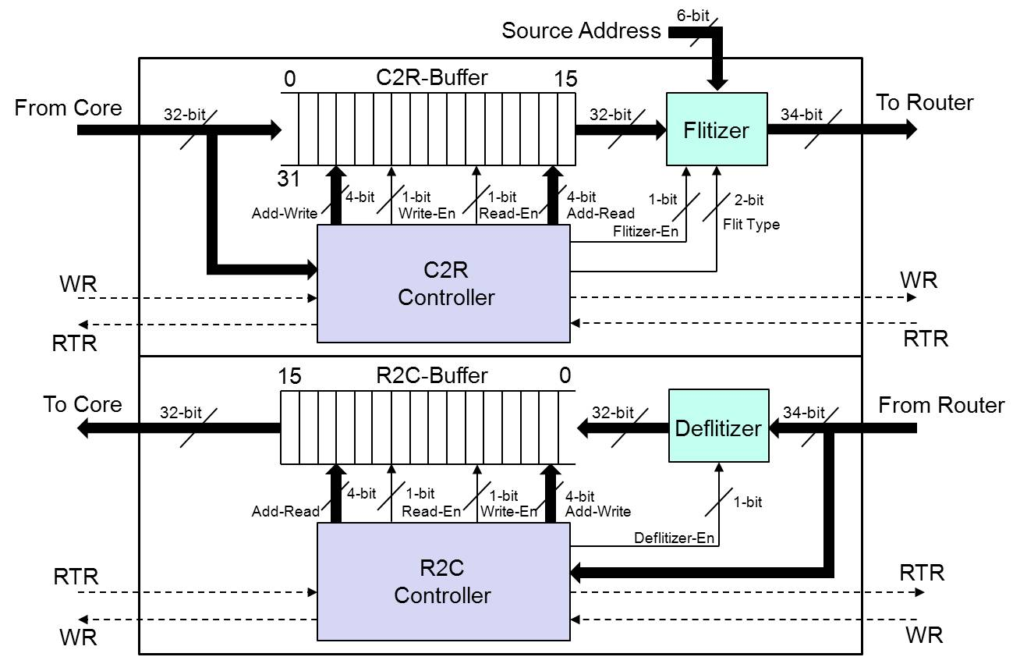
Network Interface
End
Body
Header
Payload
Source
Dest
Flit
Type
End
Body
Header
Payload
Source
Dest
Flit
Type
OASIS NoC NI
93
Notes:
93
93

Slide 94
Summary
NoC is a scalable platform for billion-transistor chips.
Several driving forces behind it.
Telecommunication devices, embedded and GP domains are attractive applications for NoC.
Expected to change the way we structure and model VLSI systems.
Many open research questions.

Slide 95

References
Akram Ben Ahmed, Shohei Miura, A. Ben Abdallah, Run-Time Monitoring Mechanism for Efficient Design of Network-on-Chip Architectures, to appear in the 6th International Workshop on Engineering Parallel and Multicore Systems (ePaMuS2013'), July 2013.
Akram Ben Ahmed, A. Ben Abdallah, Low-overhead Routing Algorithm for 3D Network-on-Chip, IEEE Proc. of the The Third International Conference on Networking and Computing (ICNC'12), pp. 23-32, 2012.
Akram Ben Ahmed, A. Ben Abdallah, LA-XYZ: Low Latency, High Throughput Look-Ahead Routing Algorithm for 3D Network-on-Chip (3D-NoC) Architecture, IEEE Proceedings of the 6th International Symposium on Embedded Multicore SoCs (MCSoC-12), pp. 167-174, 2012.
Akram Ben Ahmed, A. Ben Abdallah, ONoC-SPL Customized Network-on-Chip (NoC) Architecture and Prototyping for Data-intensive Computation Applications, IEEE Proceedings of The 4th International Conference on Awareness Science and Technology, pp. 257-262, 2012.
A. Ben Ahmed, A. Ben Abdallah, Efficient Look-Ahead Routing Algorithm for 3D Network-on-Chip (3D-NoC),IEEE Proceedings of the 6th International Symposium on Embedded Multicore SoCs (MCSoC-12,) pp. 167-174,2012.
R. Okada, Architecture and Design of Core Network Interface for Distributed Routing in OASIS NoC, Technical Report, ASL- Parallel Architecture Group, School of Computer Science and Engineering, The University of Aizu, March 2012.
A. Ben Ahmed, A. Ben Abdallah, K. Kuroda,Architecture and Design of Efficient 3D Network-on-Chip (3D NoC) for Custom Multicore SoC, IEEE Proc. of the 5th International Conference on Broadband, Wireless Computing, Communication and Applications (BWCCA-2010), pp.67-73, Nov. 2010. (best paper award) (slides)
K. Mori, A. Esch, A. Ben Abdallah, K. Kuroda, Advanced Design Issues for OASIS Network-on-Chip Architecture, IEEE Proc. of the 5th International Conference on Broadband, Wireless Computing, Communication and Applications (BWCCA-2010),pp.74-79, Nov. 2010. slides
T. Uesaka, OASIS NoC Topology Optimization with Short-Path Link, Technical Report, Systems Architecture Group,March 2011
K. Mori, A. Ben Abdallah, OASIS NoC Architecture Design in Verilog HDL, Technical Report,TR-062010-OASIS, Adaptive Systems Laboratory, the University of Aizu, June 2010. slides
Shohei Miura, Abderazek Ben Abdallah, Kenichi Kuroda, PNoC: Design and Preliminary Evaluation of a Parameterizable NoC for MCSoC Generation and Design Space Exploration, The 19th Intelligent System Symposium (FAN 2009), pp.314-317, Sep.2009.
Kenichi Mori, Abderazek Ben Abdallah, Kenichi Kuroda, Design and Evaluation of a Complexity Effective Network-on-Chip Architecture on FPGA, The 19th Intelligent System Symposium (FAN 2009), pp.318-321, Sep. 2009.
A. Ben Abdallah, T. Yoshinaga and M. Sowa, "Mathematical Model for Multiobjective Synthesis of NoC Architectures", IEEE Proc. of the 36th International Conference on Parallel Processing, Sept. 4-8, 2007.
A. Ben Abdallah, Masahiro Sowa, "Basic Network-on-Chip Interconnection for Future Gigascale MCSoCs Applications: Communication and Computation Orthogonalization", JASSST2006, Dec. 4-9th, 2006.
Book: Multicore Systems-on-Chip: Practical Hardware/Software Design, 2nd Edition, Author: A. Ben Abdallah, Publisher: Springer, (2013) , ISBN-13: 978-9491216916. [Amazon]
OASIS2 NoC Chip

