Slide 1
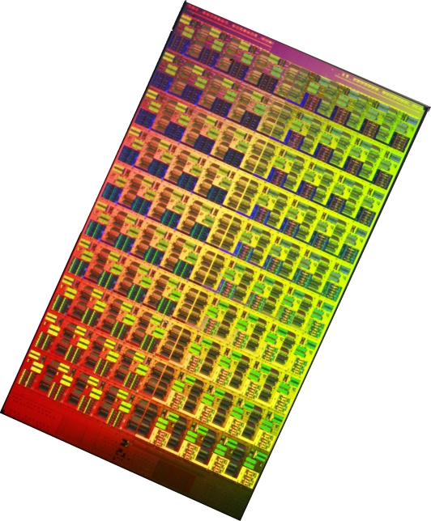
Network-on-Chip
(1/2)
Ben Abdallah Abderazek
The University of Aizu
E-mail: benab@u-aizu.ac.jp
Hong Kong University of Science and Technology, March 2013

Slide 2
Part 1
Application requirements
NoC: A paradigm shift in VLSI Design
Critical problems addressed by NoC
Traffic abstractions
Data abstraction
Network delay modeling

Slide 3
Application Requirements
Signal processing
Hard real time
Very regular load
High quality
Typically on DSPs
Media processing
Hard real time
Irregular load
High quality
SoC/media processors
Multimedia
Soft real time
Irregular load
Limited quality
PC/desktop
Very challenging.

Slide 4
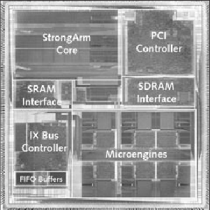
Packet Processing in Future Internet
Future Internet
ASIC
(large, expensive to
develop,
not flexible)
More packets
&
Complex packet
processing
MCSoC
General Purpose
Processors
Multicore System-on-Chip (MCSoC):
  High processing power
  Support wire speed
  Programmable
  Scalable
  Wide applications in networking areas

Slide 5
Telecommunication Systems & NoC
The trend nowadays is to integrate telecommunication system on complex MCSoC:
  Network processors,
  Multimedia hubs, and
  base-band telecom circuits
These applications have tight time-to-market and performance constraints

Slide 6
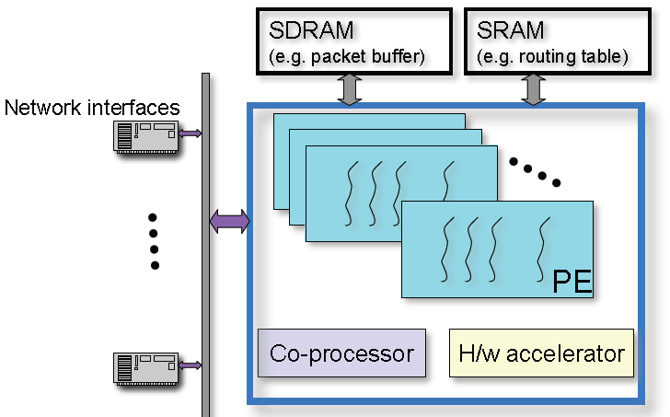
Typical NP (Network Processor)

Slide 7
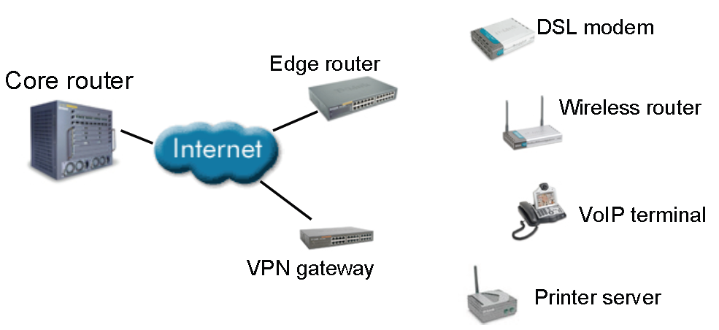
Examples of NP Applications

Slide 8
Telecommunication System Requirements
A typical telecommunication system is composed of 4 type of components:
  Software tasks
  Processors executing software
  Specific hardware cores, and
  Global on-chip communication network

Slide 9
Telecommunication System Requirements
A typical telecommunication system is composed of 4 types of components:
  Software tasks
  Processors executing software
  Specific hardware cores, and
  Global on-chip communication network
This is on of the most challenging issue.

Slide 10
Technology & Architecture Trends
Technology trends
  Vast transistor budgets
  Relatively poor interconnect scaling
  Need to manage complexity and power
  Build flexible designs (multi-/general-purpose)
Architectural trends
  Go parallel!

Slide 11
Communication Reliability
Information transfer is inherently unreliable at the electrical level, due to:
  Timing errors
  Cross-talk
  Electro-magnetic interference (EMI)
  Soft errors
The problem will get increasingly worse as technology scales down

Slide 12
Wire Delay vs. Logic Delay
Operation | Delay (.13mico) | Delay (.05micro)
32-bit ALU Operation | 650ps | 250ps
32-bit Register read | 325ps | 125ps
Read 32-bit from 8KB RAM | 780ps | 300ps
Transfer 32-bit across chip (10mm) | 1400ps | 2300ps
Transfer 32-bit across chip (200mm) | 2800ps | 4600ps
2:1 global on-chip communication to operation delay 9:1 in 2010
Ref: W.J. Dally HPCA Panel presentation 2002

Slide 13
On-chip Interconnection Types
I/O
I/O2
M1
P1
P1
P1
-Leakage Power
-Thermal Power
-Noise
P2
Many
Modules
I/O1
P3
M3
P3
M1
M2
P2
P5
Point-to-Point

Slide 14
On-chip Interconnection Types
Wait
Wait
Wait
P1
I/O
2
P2
P3
M1
P4
M2
I/O
1
P5
P6
M3
I/O
3
P7
M4
Wait
Wait
Wait
Shared bus

Slide 15
On-chip Interconnection Types
Wait
P3
M1
P4
M2
Wait
P1
I/O
2
P2
Bridge
M3
I/O
3
P7
M4
Wait
I/O
1
P5
P6
Wait
Wait
Hierarchical bus

Slide 16
On-chip Interconnection Types
M2
M3
P1
I/O
1
M1
P6
P2
P5
Wait
Wait
P3
P4
Bus matrix

Slide 17
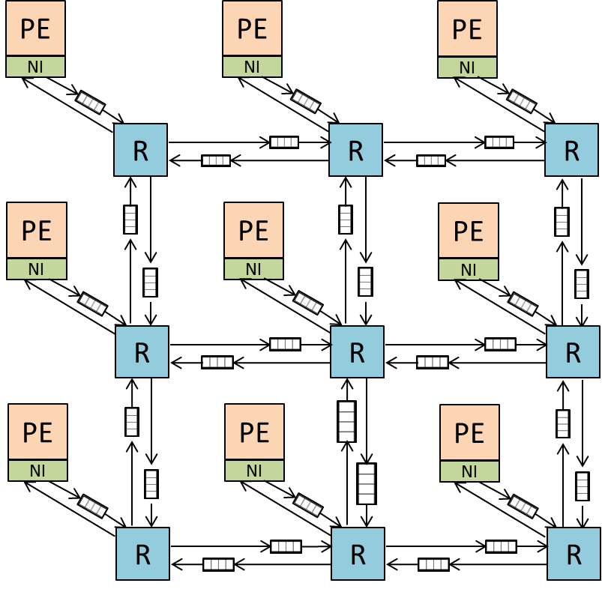
On-chip Interconnection Types
Processing
element
Router
Unidirectional
links
Network
Interface
Input
buffers
Network-on-Chip -> our main topic in this lecture.

Slide 18
On-chip Interconnection Types
Network-on-Chip -> our main topic in this lecture

Slide 19
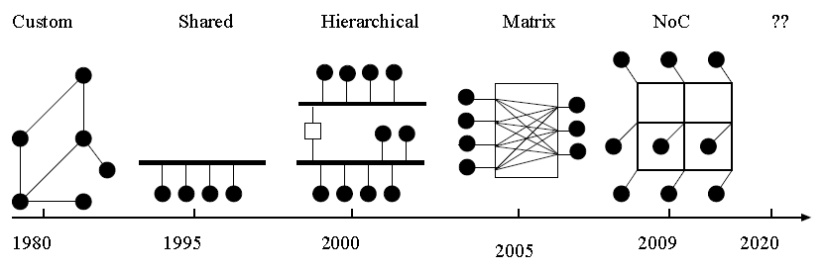
Let us Summarize all On-chip Interconnection Types
Ref.: Abderazek Ben Abdallah, Multicore Systems-on-Chip: Practical Hardware/Software Design, 2nd Edition, Publisher: Springer, (2013) , ISBN-13: 978-9491216916

Slide 20
Traditional SoC Nightmare
Variety of dedicated interfaces
Design and verification complexity
Unpredictable performance
Many underutilized wires
DMA
CPU
DSP
Control
signals
CPU Bus
A
Bridge
B
Peripheral Bus
C
IO
IO
IO

Slide 21
NoC: A paradigm Shift in VLSI
From: Dedicated signal wires
To: Shared network
s
s
s
Module
s
s
s
Module
Module
s
s
s
Point-
To-point
Link
Computing
Module
Network
switch

Slide 22
NoC: A paradigm Shift in VLSI
NI
DMA
CPU
NI
Coproc
NI
NI
DSP
switch
switch
NI
Ethnt
I/O
NI
switch
switch
NoC
NI
DMA
switch
switch
NI
MPEG
DRAM
NI
DRAM
NI
NI
Ethnt
Accel
NI

Slide 23
NoC Essential
Communication by packets of bits
Routing of packets through several hops via switches
Efficient sharing of wires
Parallelism
s
s
s
Module
s
s
s
Module
Module
s
s
s

Slide 24
NoC Operation Example
CPU
Network Interface
switch
switch
CPU request
Packetization and trans.
Routing
Receipt and unpacketization (AHB, OCP, ... pinout)
Device response
Packetization and transmission
Routing
Receipt and unpacketization
switch
Network Interface
I/O

Slide 25
Characteristics of a Paradigm Shift
Solves a critical problem
Step-up in abstraction
Design is affected:
  Design becomes more restricted
  New tools
  The changes enable higher complexity and capacity
  Jump in design productivity

Slide 26
Characteristics of a Paradigm shift
We will look at the problem addressed by NoC.
Solves a critical problem
Step-up in abstraction
Design is affected:
  Design becomes more restricted
  New tools
  The changes enable higher complexity and capacity
  Jump in design productivity

Slide 27
Don't we already know how to design interconnection networks?
Many existing network topologies, router designs and theory has already been developed for high end supercomputers and telecom switches
Yes, and we'll cover some of this material, but the trade-offs on-chip lead to very different designs!!
27

Slide 28
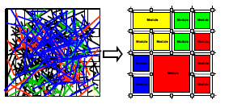
Critical problems addressed by NoC
1) Global interconnect design problem:
delay, power, noise, scalability, reliability
2) System integration
productivity problem
3) Multicore Processors
key to power-efficient computing

Slide 29

1(a): NoC and Global wire delay
Long wire delay is dominated by Resistance
Add repeaters
Repeaters become latches (with clock frequency scaling)
Latches evolve to NoC routers
NoC Router
NoC Router
NoC Router

Slide 30
1(b): Wire design for NoC
NoC links:
  Regular
  Point-to-point (no fanout tree)
  Can use transmission-line layout
  Well-defined current return path
Can be optimized for noise /speed/power ?
  Low swing,
  current mode,
  ….

Slide 31
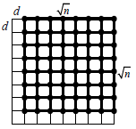
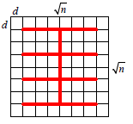
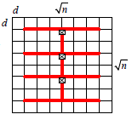
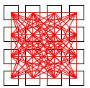
1(c): NoC Scalability
For Same Performance, compare the wire area and power
NoC:
O(n)
O(n)
Simple Bus
O(n^3 √n)
O(n√n)
Segmented Bus:
O(n^2 √n)
O(n√n)
Point –to-Point
O(n^2 √n)
O(n √n)

Slide 32
1(d): NoC and Communication Reliability
Router
n
 | …
Input buffer
UMODEM
U
MO
D
E
M
Router
U
MO
D
E
M
Error correction
Synchronization
UMODEM
ISI reduction
m
UMODEM
Parallel to Serial Convertor
U
MO
D
E
M
Router
U
MO
D
E
M
Modulation
Link Interface
UMODEM
Interconnect
Fault tolerance & error correction
A. Morgenshtein, E. Bolotin, I. Cidon, A. Kolodny, R. Ginosar, “Micro-modem – reliability solution for NOC communications”, ICECS 2004

Slide 33
1(e): NoC and GALS
Modules in NoC use different clocks
  May use different supply voltages
NoC can handle synchronization
NoC design may be asynchronous
  No waste of power when the links and routers are idle

Slide 34
2: NoC and Engineering Productivity
NoC eliminates ad-hoc global wire engineering
NoC separates computation from communication
NoC is a complete platform for system integration, debugging and testing

Slide 35
3: NoC and Multicore
Uniprocessors cannot provide Power-efficient performance growth
  Interconnect dominates dynamic power
  Global wire delay doesn’t scale
  ILP is limited
Gate
Interconnect
Diff.

Slide 36
3: NoC and Multicore
Power-efficiency requires many parallel local computations
  Multicore chip
  Thread-Level Parallelism (TLP)
Uniprocessor Performance
Die Area (or Power)

Slide 37

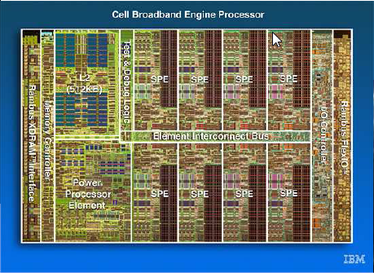
3: NoC and Multicore
Uniprocessors cannot provide Power-efficient performance growth
  Interconnect dominates dynamic power
  Global wire delay doesn’t scale
  Instruction-level parallelism is limited
Power-efficiency requires many parallel local computations
  Chip Multi Processors (CMP)
  Thread-Level Parallelism (TLP)
Network is a natural choice for CMP!

Slide 38
3: NoC and Multicore
Network is a natural choice for Multicore
Uniprocessors cannot provide Power-efficient performance growth
  Interconnect dominates dynamic power
  Global wire delay doesn’t scale
  Instruction-level parallelism is limited
Power-efficiency requires many parallel local computations
  Chip Multi Processors (CMP)
  Thread-Level Parallelism (TLP)
Network is a natural choice for CMP!

Slide 39
Why now is the time for NoC ?
Difficulty of DSM wire design
Productivity pressure
Multicore

Slide 40
Layers of Abstraction in Network Modeling
Software layers
  Application, OS
Network & transport layers
  Network topology e.g. crossbar, ring, mesh, torus, fat tree,…
  Switching Circuit / packet switching(SAF, VCT), wormhole
  Addressing Logical/physical, source/destination, flow, transaction
  Routing Static/dynamic, distributed/source, deadlock avoidance
  Quality of Service e.g. guaranteed-throughput, best-effort
  Congestion control, end-to-end flow control

Slide 41
Layers of Abstraction in Network Modeling
Data link layer
  Flow control
  Handling of contention
  Correction of transmission errors
Physical layer
  Wires, drivers, receivers, repeaters, signaling, circuits,..

Slide 42
How to Select Architecture ?
Architecture choices depends on system needs
Reconfiguration
Rate
During run time
At boot time
At design time
CMP/
Multicore
ASSP
FPGA
ASIC
Flexibility
Single application General purpose or Embedded systems

Slide 43
How to Select Architecture ?
Architecture choices depends on system needs
Reconfiguration
Rate
During run time
At boot time
At design time
A large range of solutions!
CMP/
Multicore
ASSP
FPGA
ASIC
Flexibility
Single application General purpose or Embedded systems

Slide 44
Perspective 1: NoC vs. Bus
NoC
Bus
Aggregate bandwidth grows
Link speed unaffected by N
Concurrent spatial reuse
Pipelining is built-in
Distributed arbitration
Separate abstraction layers
However:
No performance guarantee
Extra delay in routers
Area and power overhead?
Modules need NI
Unfamiliar methodology
Bandwidth is shared
Speed goes down as N grows
No concurrency
Pipelining is tough
Central arbitration
No layers of abstraction
(communication and computation are coupled)
However:
Fairly simple and familiar

Slide 45
Perspective 2: NoC vs. Off-chip Networks
NoC
Off-Chip Networks
Sensitive to cost:
  area
  power
Wires are relatively cheap
Latency is critical
Traffic may be known a-priori
Design time specialization
Custom NoCs are possible
Cost is in the links
Latency is tolerable
Traffic/applications unknown
Changes at runtime
Adherence to networking standards

Slide 46
VLSI CAD Problems
Application mapping
Floorplanning (placement)
Routing
Buffer sizing
Timing closure
Simulation
Testing

Slide 47
VLSI CAD Problems in NoC
Application mapping (map tasks to cores)
Floorplanning (within the network)
Routing (of messages)
Buffer sizing (size of FIFO queues in the routers)
Simulation (Network simulation, traffic/delay/power modeling)
Other NoC design problems (topology synthesis, switching, virtual channels, arbitration, flow control,……)

Slide 48
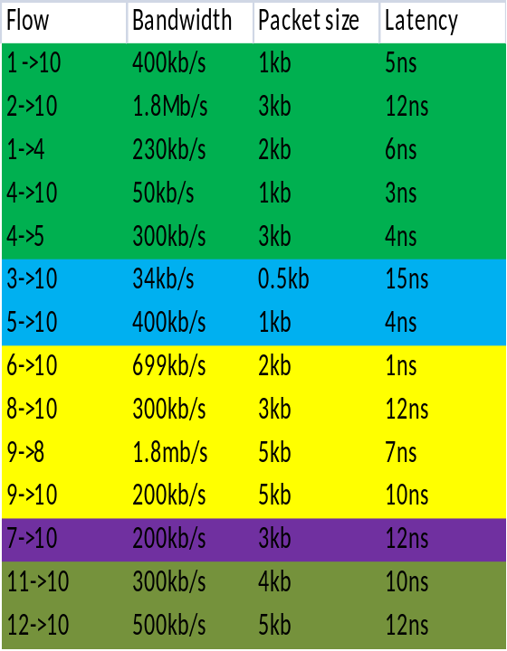
Traffic Abstractions
Traffic model are generally captured from actual traces of functional simulation
A statically distribution is often assumed for message
PE1
PE2
PE3
PE12
PE4
PE10
PE11
PE5
PE9
PE7
PE8
PE6

Slide 49
Data Abstractions
Message
Packet | Packet | Packet | Packet
Packet
Head Flit | Body Flit | Body Flit | Tail Flit
Flit
Type | Sequence # | VC | data
Phit

Slide 50
Typical NoC Design Flow
Determine routing and adjust link capacities

Slide 51
Timing Closure in NoC
Define inter-module traffic
Place modules
Increase link capacities
QoS satisfied ?
No
Yes
Finish
Too long capacity results in poor QoS
Too high capacity wastes area
Uniform link capacities are a waste in ASIP system

Slide 52
NoC Design Requirements
High-performance interconnect
  High-throughput, latency, power, area
Complex functionality
  Support for virtual-channels
  QoS
Synchronization
  Reliability, high-throughput, low-latency

Slide 53
Break + Questions

Slide 54
Part II: NoC Building Blocks
Topology
Routing
Control Flow
Network Interface
Router Architecture

Slide 55
Part II: NoC Building Blocks
Topology
Routing Algorithms
Routing Mechanisms
Control Flow
Network Interface
Router Architecture

Slide 56
NoC Topology
NoC topology is the connection map
between PEs.
Mainly adopted from large-scale networks and parallel computing
A good topology allows to fulfill the requirements of the traffic at reasonable costs
Topology classifications:
  Direct topologies
  Indirect topologies
Notes:
The ring is the least complex topology where router nodes are connected in a circular fashion, but scalability is poor due to limited connectivity.
Mesh: Meshes have a relatively large average network distance, which can increase power consumption. Moreover, concentrated areas of high traffic within the grid, called hotspots, may occur
The 2-D Torus is similar to a mesh, but extended with wrap-around links to reduce average network distance. A two-dimensional torus has a similar area footprint
as the mesh, with the overhead in added links.
An irregular topology can be derived by altering the connectivity of a regular topology
(i.e., one of the topologies described thus far), to form hybrid, cluster-based, or
asymmetric topologies

Slide 57
Direct Topology: Mesh
PE
PE
PE
PE
R
PE
R
PE
R
PE
R
PE
R
PE
R
PE
R
PE
R
PE
R
PE
R
PE
R
PE
R
PE
R
R
R
R
Notes:
The main problem with the mesh topology is its long diameter that has negative effect on communication latency.
Torus topology was proposed to reduce the latency of mesh and keep its simplicity.
The only difference between torus and mesh topologies is that the switches on the edges are connected to the switches on the opposite edges through wrap-around channels.

Slide 58
Direct Topology: Torus
PE
PE
PE
PE
R
PE
R
PE
R
PE
R
PE
R
PE
R
PE
R
PE
R
PE
R
PE
R
PE
R
PE
R
PE
R
R
R
R
Notes:
The main problem with the mesh topology is its long diameter that has negative effect on communication latency.
Torus topology was proposed to reduce the latency of mesh and keep its simplicity.
The only difference between torus and mesh topologies is that the switches on the edges are connected to the switches on the opposite edges through wrap-around channels.

Slide 59
Direct Topology: Folded Torus
PE
PE
PE
PE
PE
PE
PE
PE
R
R
R
R
R
R
PE
PE
PE
PE
PE
PE
Fold
R
R
PE
PE
R
R
R
R
R
R
PE
PE
PE
PE
PE
PE
R
R
PE
PE
R
R
R
R
R
R
PE
PE
PE
PE
PE
PE
R
R
PE
PE
R
R
R
R
R
R
R
R
Notes:
The main problem with the mesh topology is its long diameter that has negative effect on communication latency.
Torus topology was proposed to reduce the latency of mesh and keep its simplicity.
The only difference between torus and mesh topologies is that the switches on the edges are connected to the switches on the opposite edges through wrap-around channels.

Slide 60
Direct Topology: Folded Torus
PE
PE
PE
PE
PE
PE
PE
PE
R
R
R
R
R
R
PE
PE
PE
PE
PE
PE
Fold
R
R
PE
PE
R
R
R
R
R
R
PE
PE
PE
PE
PE
PE
R
R
PE
PE
R
R
R
R
R
R
PE
PE
PE
PE
PE
PE
R
R
PE
PE
R
R
R
R
R
R
R
R
Notes:
The main problem with the mesh topology is its long diameter that has negative effect on communication latency.
Torus topology was proposed to reduce the latency of mesh and keep its simplicity.
The only difference between torus and mesh topologies is that the switches on the edges are connected to the switches on the opposite edges through wrap-around channels.

Slide 61
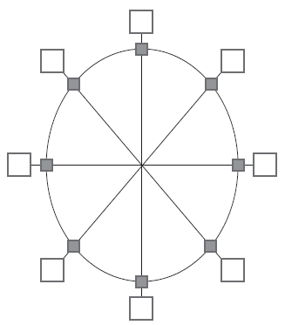
Direct Topology: Octagon
PE
PE
PE
SW
PE
PE
PE
PE
PE
Notes:
The main problem with the mesh topology is its long diameter that has negative effect on communication latency.
Torus topology was proposed to reduce the latency of mesh and keep its simplicity.
The only difference between torus and mesh topologies is that the switches on the edges are connected to the switches on the opposite edges through wrap-around channels.

Slide 62
Indirect Topology: Fat Tree
SW
SW
SW
SW
SW
SW
SW
PE
PE
PE
PE
PE
PE
PE
PE
Notes:
The main problem with the mesh topology is its long diameter that has negative effect on communication latency.
Torus topology was proposed to reduce the latency of mesh and keep its simplicity.
The only difference between torus and mesh topologies is that the switches on the edges are connected to the switches on the opposite edges through wrap-around channels.

Slide 63
Indirect Topology: k-ary n-fly butterfly network
PE
PE
SW
SW
SW
PE
PE
PE
PE
SW
SW
SW
PE
PE
PE
PE
SW
SW
SW
PE
PE
PE
PE
SW
SW
SW
PE
PE
Notes:
The main problem with the mesh topology is its long diameter that has negative effect on communication latency.
Torus topology was proposed to reduce the latency of mesh and keep its simplicity.
The only difference between torus and mesh topologies is that the switches on the edges are connected to the switches on the opposite edges through wrap-around channels.

Slide 64
Indirect Topology:
(m, n, r) symmetric Clos network
0
0
1
SW
SW
SW
1
2
2
3
3
4
SW
SW
4
5
5
SW
6
6
7
SW
SW
7
8
8
9
9
10
SW
SW
SW
10
11
11
Notes:
The main problem with the mesh topology is its long diameter that has negative effect on communication latency.
Torus topology was proposed to reduce the latency of mesh and keep its simplicity.
The only difference between torus and mesh topologies is that the switches on the edges are connected to the switches on the opposite edges through wrap-around channels.

Slide 65
How to Select a Topology ?
Application decides the topology type
  if PEs = few tens → Mesh is recommended
  if PEs = 100 or more → Hierarchical star is recommended
Some topologies are better for certain designs than others

Slide 66
Part II: NoC Building Blocks
Topology
Routing Algorithms
Routing Mechanisms
Control Flow
Network Interface
Router Architecture

Slide 67
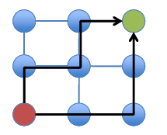
NoC Routing
Routing algorithm determine path(s) from source to destination. Routing must prevent deadlock, livelock , and starvation.

Slide 68
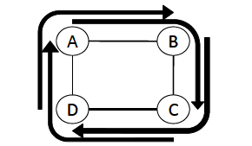
Routing Deadlock
Without routing restrictions, a resource cycle can occur
  Leads to deadlock

Slide 69
Deadlock, Livelock, and Starvation
Deadlock: A packet does not reach its destination, because it is blocked at some intermediate resource.
Livelock: A packet does not reach its destination, because it enters a cyclic path.
Starvation: A packet does not reach its destination, because some resource does not grant access (wile it grants access to other packets).

Slide 70
Lifelock
PE
PE
PE
D
R
R
R
R
PE
PE
PE
PE
R
R
R
R
Lifelock
PE
PE
PE
PE
R
R
R
R
S
PE
PE
PE
R
R
R
R
Congested channel

Slide 71
Deadlock
Dest 02
Dest 01
Dest 00
Dest 01
10
11
12
Dest 02
Dest 01
Dest 02
Dest 01
00
01
02
Dest 12
Dest 03
Dest 11
Dest 11
Dest 12
Dest 22
Dest 12
Dest 22

Slide 72
Deadlock
Dest 00
Dest 01
Dest 02
Dest 01
10
11
12
Dest 02
Dest 02
Dest 01
Dest 01
00
Dest 12
01
02
Dest 03
Dest 11
Dest 11
Dest 12
Dest 22
Dest 12
Dest 22

Slide 73
Deadlock
Dest 00
Dest 02
Dest 01
10
11
BLOCK
12
Dest 02
Dest 01
Dest 01
Dest 01
DEADLOCK
Dest 11
BLOCK
BLOCK
Dest 02
00
Dest 03
Dest 12
01
02
BLOCK
Dest 12
Dest 11
Dest 12
Dest 22
Dest 22

Slide 74
Routing Algorithm Attributes
Number of destinations
  Unicast, Multicast, Broadcast?
Adaptivity
  Deterministic, Oblivious or Adaptive
Implementation (Mechanisms)
  Source or node routing?
  Table or circuit?

Slide 75
Static Vs. Adaptive Routing
PE
PE
PE
PE
PE
PE
PE
PE
R
R
R
R
R
R
R
R
PE
PE
PE
PE
PE
PE
PE
PE
R
R
R
R
R
R
R
R
PE
PE
PE
PE
PE
PE
PE
PE
R
R
R
R
R
R
R
R
PE
PE
PE
PE
PE
PE
PE
PE
R
R
R
R
R
R
R
R
Static
Adaptive
Congested channel

Slide 76
Minimal Vs. Non-Minimal
PE
PE
PE
PE
PE
PE
PE
PE
R
R
R
R
R
R
R
R
PE
PE
PE
PE
PE
PE
PE
PE
R
R
R
R
R
R
R
R
PE
PE
PE
PE
PE
PE
PE
PE
R
R
R
R
R
R
R
R
PE
PE
PE
PE
PE
PE
PE
PE
R
R
R
R
R
R
R
R
Minimal
Non-Minimal

Slide 77
Source Vs. Distributed
PE
PE
PE
PE
PE
PE
PE
PE
R
R
R
R
R
R
R
R
PE
PE
PE
PE
PE
PE
PE
PE
R
R
R
R
R
R
R
R
PE
PE
PE
PE
PE
PE
PE
PE
R
R
R
R
R
R
R
R
E
N
E
S
E
N
N
N
L
PE
PE
PE
PE
PE
PE
PE
PE
R
R
R
R
R
R
R
R
Source
Distributed

Slide 78
Source Vs. Distributed
PE
PE
PE
PE
PE
PE
PE
PE
R
R
R
R
R
R
R
R
PE
PE
PE
PE
PE
PE
PE
PE
R
R
R
R
R
R
R
R
PE
PE
PE
PE
PE
PE
PE
PE
R
R
R
R
R
R
R
R
PE
PE
PE
PE
PE
PE
PE
PE
Routing
Computation
R
R
N
R
R
R
R
R
R
E
E
S
E
N
N
N
L
Source
Distributed

Slide 79
Source Vs. Distributed
PE
PE
PE
PE
PE
PE
PE
PE
R
R
R
R
R
R
R
R
PE
PE
PE
PE
PE
PE
PE
PE
R
R
R
R
R
R
R
R
PE
PE
PE
PE
PE
PE
PE
PE
R
R
R
R
R
R
R
R
PE
PE
PE
PE
PE
PE
PE
PE
Routing
Computation
R
N
E
R
R
R
R
R
R
R
E
S
N
N
N
L
Source
Distributed

Slide 80
Source Vs. Distributed
PE
PE
PE
PE
PE
PE
PE
PE
R
R
R
R
R
R
R
R
PE
PE
PE
PE
PE
PE
PE
PE
R
R
R
R
R
R
R
R
PE
PE
PE
PE
PE
PE
PE
PE
Routing
Computation
R
R
E
E
R
R
R
R
R
R
S
N
N
N
L
PE
PE
PE
PE
PE
PE
PE
PE
R
R
R
R
R
R
R
R
Source
Distributed

Slide 81
Source Vs. Distributed
PE
PE
PE
PE
PE
PE
PE
PE
R
R
R
R
R
R
R
R
PE
PE
PE
PE
PE
PE
PE
PE
R
R
R
R
R
R
R
R
PE
PE
PE
PE
PE
PE
PE
PE
Routing
Computation
R
R
S
E
N
R
R
R
R
R
R
N
N
L
PE
PE
PE
PE
PE
PE
PE
PE
R
R
R
R
R
R
R
R
Source
Distributed

Slide 82
Source Vs. Distributed
PE
PE
PE
PE
PE
PE
PE
PE
R
R
R
R
R
R
R
R
PE
PE
PE
PE
PE
PE
PE
PE
R
R
R
R
R
R
R
R
PE
PE
PE
PE
PE
PE
PE
PE
R
R
R
R
R
R
R
R
PE
PE
PE
PE
PE
PE
PE
PE
Routing
Computation
R
R
N
R
R
R
R
R
R
E
N
N
L
Source
Distributed

Slide 83
Source Vs. Distributed
PE
PE
PE
PE
PE
PE
PE
PE
R
R
R
R
R
R
R
R
PE
PE
PE
PE
PE
PE
PE
PE
R
R
R
R
R
R
R
R
PE
PE
PE
PE
PE
PE
PE
PE
R
R
R
R
R
R
R
R
PE
PE
PE
PE
PE
PE
PE
PE
Routing
Computation
R
R
R
N
N
R
L
R
R
R
R
N
Source
Distributed

Slide 84
Source Vs. Distributed
PE
PE
PE
PE
PE
PE
PE
PE
R
R
R
R
R
R
R
R
PE
PE
PE
PE
PE
PE
PE
PE
R
R
R
R
R
R
R
R
PE
PE
PE
PE
PE
PE
PE
PE
Routing
Computation
R
R
R
R
R
R
R
R
N
N
L
PE
PE
PE
PE
PE
PE
PE
PE
R
R
R
R
R
R
R
R
Source
Distributed

Slide 85
Source Vs. Distributed
PE
PE
PE
PE
PE
PE
PE
PE
R
R
R
R
R
R
R
R
PE
PE
PE
PE
PE
PE
PE
PE
Routing
Computation
R
R
R
N
R
R
R
R
R
L
PE
PE
PE
PE
PE
PE
PE
PE
R
R
R
R
R
R
R
R
PE
PE
PE
PE
PE
PE
PE
PE
R
R
R
R
R
R
R
R
Source
Distributed

Slide 86
Source Vs. Distributed
PE
PE
PE
PE
PE
PE
PE
PE
Routing
Computation
R
R
R
R
R
R
R
R
L
PE
PE
PE
PE
PE
PE
PE
PE
R
R
R
R
R
R
R
R
PE
PE
PE
PE
PE
PE
PE
PE
R
R
R
R
R
R
R
R
PE
PE
PE
PE
PE
PE
PE
PE
R
R
R
R
R
R
R
R
Source
Distributed

Slide 87
Routing examples
PE
PE
PE
D
R
R
R
R
PE
PE
PE
PE
R
R
R
R
PE
PE
PE
PE
R
R
R
R
Y
S
PE
PE
PE
X
R
R
R
R
Dimension Ordered Routing (XY Routing)

Slide 88
Routing examples
Random Intermediate node
PE
PE
PE
PE
R
R
R
R
PE
PE
PE
D
R
R
R
R
PE
PE
PE
PE
R
R
R
R
Y
S
PE
PE
PE
X
R
R
R
R
Valiant routing algorithm
(VAL)

Slide 89
Routing examples
PE
PE
PE
PE
Intermediate node within bounding box
R
R
R
R
PE
PE
PE
D
R
R
R
R
Bounding Box
PE
PE
PE
PE
R
R
R
R
Y
S
PE
PE
PE
X
R
R
R
R
ROMM

Slide 90
Routing examples
PE
PE
PE
PE
R
R
R
R
PE
PE
PE
D
R
R
R
R
PE
PE
PE
PE
50% YX
R
R
R
R
50% XY
Y
S
PE
PE
PE
X
R
R
R
R
O1TURN

Slide 91
Routing examples
Congested channel
PE
PE
PE
PE
R
R
R
R
PE
PE
PE
D
R
R
R
R
PE
PE
PE
PE
R
R
R
R
Y
S
PE
PE
PE
X
R
R
R
R
Dynamic XY
(DyXY)

Slide 92
Summary of Routing Algorithms
Deterministic algorithms are simple and inexpensive but they do utilize path diversity and thus are weak on load balancing
Oblivious algorithms give often good results since they allow good load balancing and their effects are easy to analyse
Adaptive algorithms although in theory superior, are complex and power hungry

Slide 93
Summary of Routing Algorithms
Latency paramount concern
  Minimal routing most common for NoC
  Non‐minimal can avoid congestion and deliver low latency
NoC researchers favor DOR for simplicity and deadlock freedom
Here we only cover unicast routing

Slide 94
Part II: NoC Building Blocks
Topology
Routing Algorithms
Routing Mechanisms
Control Flow
Network Interface
Router Architecture

Slide 95
Routing Mechanism
The term routing mechanics refers to the mechanism that is used to implement any routing algorithm.
Two approaches:
  Fixed routing tables at the source or at each hop
  Algorithmic routing uses specialized hardware to compute the route or next hop at run-time

Slide 96
Table-based Routing
Two approaches:
  Source-table routing implements all-at-once routing by looking up the entire route at the source
  Node-table routing performs incremental routing by looking up the hop-by-hop routing relation at each node along the route
Major advantage:
  A routing table can support any routing relation on any topology.

Slide 97
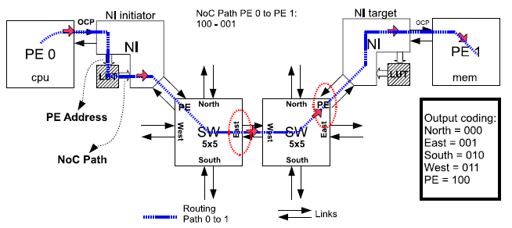
Table-based Routing
Example routing mechanism for deterministic source routing NoCs. The NI uses a LUT to store the route map.

Slide 98
Source Routing
All routing decisions are made at the source terminal
To route a packet we need:
  the table is indexed using the packet destination
  a route or a set of routes are returned, one route is selected
  the route is prepended and embedded in the packet
Because of its speed, simplicity and scalability source routing is very often used for deterministic and oblivious routing

Slide 99
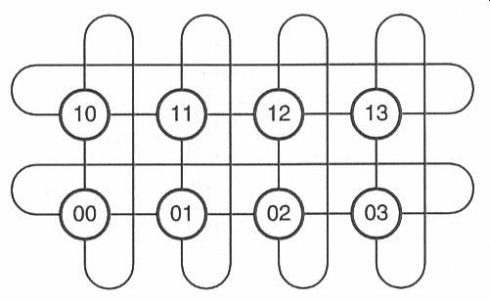
Source Routing - Example
The example shows a routing table for a 4x2 torus network
In this example there are two alternative routes for each destination
Each node has its own routing table
01
11
21
31
00
10
20
30
4x2 torus network
In this example the order of XY
should be the opposite, i.e. 21->12
Source routing table for node 00 of 4x2 torus network
Destination | Route 0 | Route 1
00 | X | X
10 | EX | WWWX
20 | EEX | WWX
30 | WX | EEEX
01 | NX | SX
11 | NEX | ENX
21 | NEEX | WWNX
31 | NWX | WNX
Example:
-Routing from 00 to 21
-Table is indexed with 21
-Two routes:
NEEX and WWNX
-The source arbitrarily
selects NEEX
index
select

Slide 100
Arbitrary Length Encoding of Source Routes
Advantage:
  It can be used for arbitrary-sized networks
The complexity of routing is moved from the network nodes to the terminal nodes
But routers must be able to handle arbitrary length routes

Slide 101
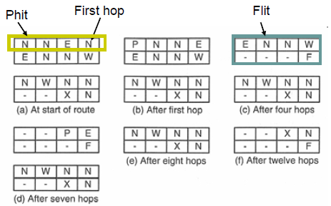
Arbitrary Length-Encoding
Router has
  16-bit phits
  32-bit flits
  Route has 13 hops: NENNWNNENNWNN
Extra symbols:
  P: Phit continuation selector
  F: Flit continuation Phit
The tables entries in the terminals must be of arbitrary length

Slide 102
Node-Table Routing
Table-based routing can also be performed by placing the routing table in the routing nodes rather than in the terminals
Node-table routing is appropriate for adaptive routing algorithms, since it can use state information at each node

Slide 103
Node-Table Routing
A table lookup is required, when a packet arrives at a router, which takes additional time compared to source routing
Scalability is sacrificed, since different nodes need tables of varying size
Difficult to give two packets arriving from a different node a different way through the network without expanding the tables

Slide 104
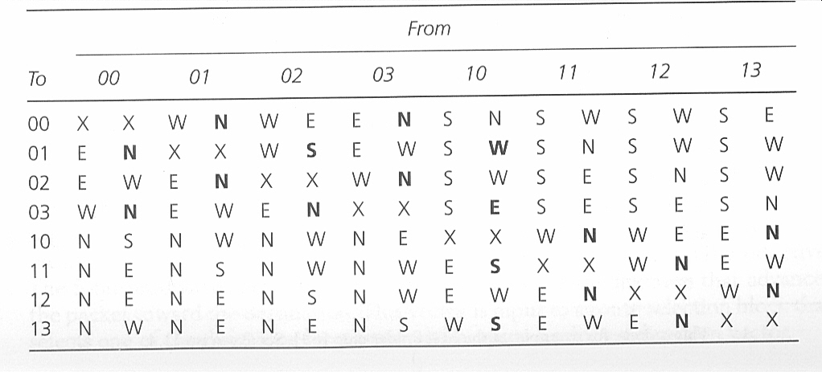
Example of Node-Table Routing
Table shows a set of routing tables
There are two choices from a source to a destination
01
11
21
31
00
10
20
30
Routing Table for Node 00
Note: Bold font ports are misroutes

Slide 105
Example of Node-Table Routing
Livelock can occur
A packet passing through node 00
destined for node 11.
If the entry for (00->11) is N ,
go to 10 and (10-> 11) is S
=> 00 <-> 10 (livelock)
01
11
21
31
00
10
20
30

Slide 106
Algorithmic Routing
Instead of using a table, algorithms can be used to compute the next route
In order to be fast, algorithms are usually not very complicated and implemented in hardware

Slide 107
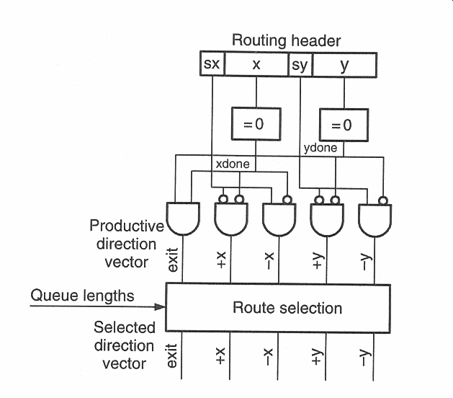
Example: Algorithmic Routing
Dimension-Order Routing
  sx and sy indicated the preferred directions
    sx=0, +x; sx=1, -x
    sy=0, +y; sy=1, -y
  x and y represent the number of hops in x and y direction
  The PDV is used as an input for selection of a route
Determines the type of the routing
Indicates which channels advance the packet

Slide 108
Example: Algorithmic Routing
A minimal oblivious router - Implemented by randomly selecting one of the active bits of the PDV as the selected direction
Minimal adaptive router - Achieved by making selection based on the length of the respective output Qs.
Fully adaptive router – Implemented by picking up unproductive direction if Qs > threshold results

Slide 109
Exercise
Compression of source routes. In the source routes, each port selector symbol [N,S,W,E, and X] was encoded with three bits. Suggest an alternative encoding to reduce the average length (in bits) required to represent a source route. Justify your encoding in terms of typical routes that might occur on a torus. Also compare the original three bits per symbol with your encoding on the following routes:
NNNNNEEX
WNEENWWWWWNX

Slide 110
Next lecture
Part II: NoC Building Blocks
Topology
Routing Algorithms
Routing Mechanisms
Switching
Control Flow
Network Interface
Router Architecture
Part III: OASIS NoC Real Design

