Slide 1
Using Genetic Algorithm to Generate Chinese Poetry
LANG5001
Chang, Zhangyu

Slide 2
What can we get from a computer?
Computer Science research papers?
Philosophical essays?
Funny short stories?
Poetry?

Slide 3
What can we get from a computer?
“I Spent an Interesting Evening Recently with a Grain of Salt.”
“Perhaps only the allegory of simulation is unendurable--more cruel than Artaud's Theatre of Cruelty, which was the first to practice deterrence, abstraction, disconnection, deterritorialisation, etc.; and if it were our own past. We are witnessing the end of the negative form. But nothing separates one pole from the very swing of voting ''rights'' to electoral...”

Slide 4
What can we get from a computer?
“One day Joe Bear was hungry. He asked his friend Irving Bird where some honey was. Irving told him there was a beehive in the oak tree. Joe threatened to hit Irving if he didn't tell him where some honey was. The End.”
“Joe Bear was hungry. He asked Irving Bird where some honey was. Irving refused to tell him, so Joe offered to bring him a worm if he'd tell him where some honey was. Irving agreed. But Joe didn't know where any worms were, so he asked Irving, who refused to say. So Joe offered to bring him a worm if he'd tell him where a worm was. Irving agreed. But Joe didn't know where any worms were, so he asked Irving, who refused to say. So Joe offered to bring him a worm if he'd tell him where a worm was...”

Slide 5
What can we get from a computer?
Synthesized texts have weird logic
Synthesized texts are exceptionally obscure

Slide 6
What About Poetry?
They have rigid format
Rhyme requirement
Not necessarily understandable

Slide 7
What About Poetry?
Treat creating poetry as a combinatorial optimization problem.
Infinite monkey theorem: A monkey hitting keys at random on a typewriter keyboard for an infinite amount of time will almost surely type a given text, such as the complete works of William Shakespeare.
Proof:http://en.wikipedia.org/wiki/Infinite_monkey_theorem

Slide 8
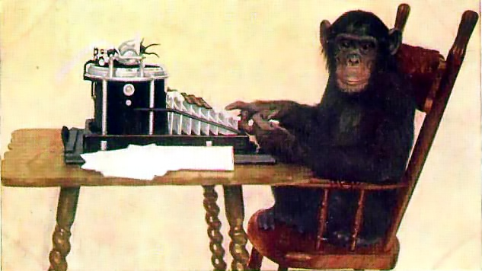
GAP: THE Probability is TOO low

Slide 9
GAP: THE Probability is TOO low
The number of possible combinations in one line of text is more than the number of atoms in the whole solar system.
50⁵⁰

Slide 10
GENETIC ALGORITHM
The idea comes from “evolution” in Biology
Treat the texts as DNAs (genes)
Measure the fitness of each text (How?)
Let the text with higher fitness to get more copy and eliminate those who has low fitness (natural selection)
Change the remaining text a little bit (mutation)

Slide 11
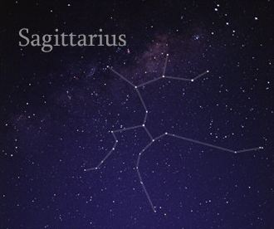
How To Measure the Fitness?
Information theory
Less probability indicates more information
“I have a father.”
“I have a father from Sagittarius.”

Slide 12
How To Measure the Fitness?
Ah Ah Ah Ah Ah
Ah Ah Ah Ah Ah
Ah Ah Ah Ah Ah
Ah Ah Ah Ah Ah
Ah Ah Ah Ah Ah
Ah Ah Ah Ah Ah
Ah Ah Ah Ah Ah
Ah Ah Ah Ah Oh!
Ah Eh Ah Oh Oh
Eh Eh Oh Oh Ah
Oh Ah Eh Oh Ah
Eh Ah Oh Oh Ah

Slide 13
What we expect?
More natural and readable text
By analyzing the parameters of the program, we may get a better understanding of how to write poem.

Slide 14
Thank you

Slide 15
Examples(1)
一个人来到田纳西
Come to Tennessee Alone
毫无疑问
我做的馅饼
是全天下
最好吃的
It is no doubt that
My pizza
Is the best
In the world

Slide 16
Examples(2)
我终于在一棵树下发现
Finally, under a tree I found
一只蚂蚁
另一只蚂蚁
一群蚂蚁
可能还有更多的蚂蚁
An ant
Another ant
A swarm of ants
Maybe there are more ants

