Slide 1
Earthquake Shakes Twitter User:
Analyzing Tweets for Real-Time Event Detection
Takehi Sakaki Makoto Okazaki Yutaka Matsuo
@tksakaki @okazaki117 @ymatsuo
the University of Tokyo

Slide 2
Outline
Introduction
Event Detection
Model
Experiments And Evaluation
Application
Conclusions

Slide 3
Outline
Introduction

Slide 4
What’s happening?
Twitter
  is one of the most popular microblogging services
  has received much attention recently
Microblogging
  is a form of blogging
    that allows users to send brief text updates
  is a form of micromedia
    that allows users to send photographs or audio clips
In this research, we focus on an important characteristic
real-time nature

Slide 5
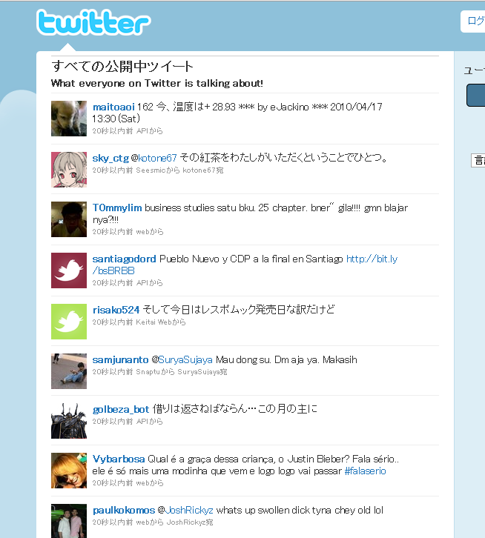
Real-time Nature of Microblogging
disastrous events
storms
fires
traffic jams
riots
heavy rain-falls
earthquakes
social events
parties
baseball games
presidential campaign
  Twitter users write tweets several times in a single day.
  There is a large number of tweets, which results in many reports related to events
  We can know how other users are doing in real-time
  We can know what happens around other users in real-time.

Slide 6
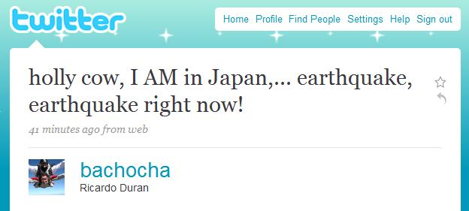
Our motivation
Adam Ostrow, an Editor in Chief at Mashable wrote the possibility to detect earthquakes from tweets in his blog
Japan Earthquake Shakes Twitter Users ... And Beyonce:
Earthquakes are one thing you can bet on being covered on Twitter first, because, quite frankly, if the ground is shaking, you’re going to tweet about it before it even registers with the USGS* and long before it gets reported by the media.
That seems to be the case again today, as the third earthquake in a week has hit Japan and its surrounding islands, about an hour ago.
The first user we can find that tweeted about it was Ricardo Duran of Scottsdale, AZ, who, judging from his Twitter feed, has been traveling the world, arriving in Japan yesterday.
we can know earthquake occurrences from tweets
=the motivation of our research
*USGS : United States Geological Survey

Slide 7
Our Goals
propose an algorithm to detect a target event
  do semantic analysis on Tweet
    to obtain tweets on the target event precisely
  regard Twitter user as a sensor
    to detect the target event
    to estimate location of the target
produce a probabilistic spatio-temporal model for
  event detection
  location estimation
propose Earthquake Reporting System using Japanese tweets

Slide 8
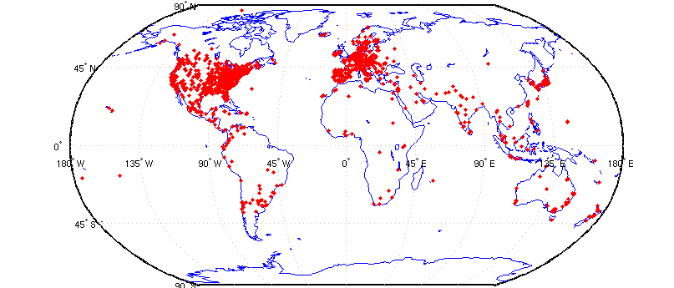
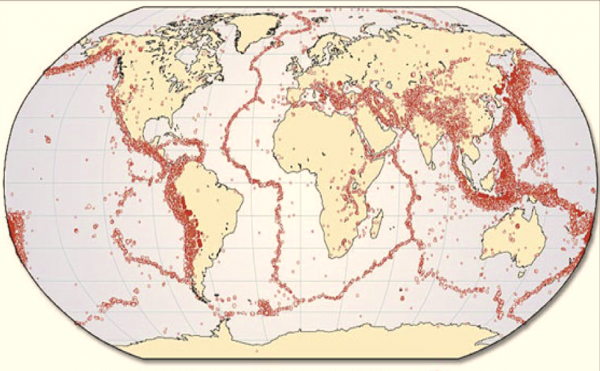
Twitter and Earthquakes in Japan
a map of Twitter user
world wide
a map of earthquake occurrences world wide
The intersection is regions with many earthquakes and large twitter users.

Slide 9
Twitter and Earthquakes in Japan
Other regions:
Indonesia, Turkey, Iran, Italy, and Pacific coastal US cities

Slide 10
Outline
Event Detection

Slide 11
Event detection algorithms
do semantic analysis on Tweet
  to obtain tweets on the target event precisely
regard Twitter user as a sensor
  to detect the target event
  to estimate location of the target

Slide 12
Semantic Analysis on Tweet
Search tweets including keywords related to a target event
  Example: In the case of earthquakes
    “shaking”, “earthquake”
Classify tweets into a positive class or a negative class
  Example:
    “Earthquake right now!!” ---positive
    “Someone is shaking hands with my boss” --- negative
  Create a classifier

Slide 13
Semantic Analysis on Tweet
Create classifier for tweets
  use Support Vector Machine(SVM)
Features (Example: I am in Japan, earthquake right now!)
  Statistical features (7 words, the 5th word)
  the number of words in a tweet message and the position of the query within a tweet
  Keyword features ( I, am, in, Japan, earthquake, right, now)
  the words in a tweet
  Word context features (Japan, right)
  the words before and after the query word

Slide 14






Tweet as a Sensory Value
Event detection from twitter
Object detection in
ubiquitous environment
Probabilistic model
Probabilistic model
Classifier
values
tweets
・・・
・・・
・・・
・・・
・・・
observation by twitter users
observation by sensors
target event
target object
the correspondence between tweets processing and
sensory data detection

Slide 15
Tweet as a Sensory Value
Event detection from twitter
Object detection in
ubiquitous environment
detect an earthquake
detect an earthquake
search and classify them into positive class
some earthquake sensors responses positive value
Probabilistic model
Probabilistic model
Classifier
values
tweets
・・・
・・・
・・・
・・・
・・・
some users posts
“earthquake right now!!”
observation by twitter users
observation by sensors
earthquake occurrence
target event
target object
We can apply methods for sensory data detection to tweets processing

Slide 16
Tweet as a Sensory Value
We make two assumptions to apply methods for observation by sensors
Assumption 1: Each Twitter user is regarded as a sensor
  a tweet →a sensor reading
  a sensor detects a target event and makes a report probabilistically
  Example:
    make a tweet about an earthquake occurrence
    “earthquake sensor” return a positive value
Assumption 2: Each tweet is associated with a time and location
  a time : post time
  location : GPS data or location information in user’s profile
Processing time information and location information, we can detect target events and estimate location of target events

Slide 17
Outline
Model

Slide 18
Probabilistic Model
Why we need probabilistic models?
  Sensor values are noisy and sometimes sensors work incorrectly
  We cannot judge whether a target event occurred or not from one tweets
  We have to calculate the probability of an event occurrence from a series of data
We propose probabilistic models for
  event detection from time-series data
  location estimation from a series of spatial information

Slide 19
Temporal Model
We must calculate the probability of an event occurrence from multiple sensor values
We examine the actual time-series data to create a temporal model

Slide 20
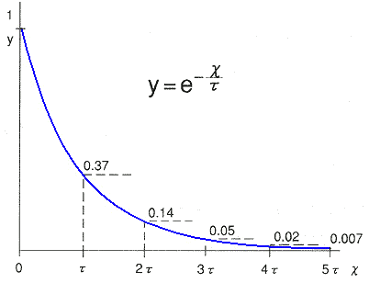
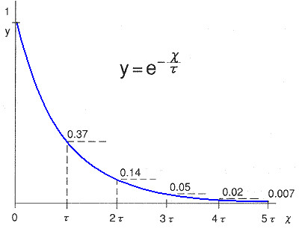
Temporal Model
Notes:
.

Slide 21
Temporal Model
the data fits very well to an exponential function
design the alarm of the target event probabilistically ,which was based on an exponential distribution

Slide 22
Spatial Model
We must calculate the probability distribution of location of a target
We apply Bayes filters to this problem which are often used in location estimation by sensors
  Kalman Filers
  Particle Filters

Slide 23
Bayesian Filters for Location Estimation
Kalman Filters
  are the most widely used variant of Bayes filters
  approximate the probability distribution which is virtually identical to a uni-modal Gaussian representation
  advantages: the computational efficiency
  disadvantages: being limited to accurate sensors or sensors
  with high update rates

Slide 24
Bayesian Filters for Location Estimation
Particle Filters
  represent the probability distribution by sets of samples, or particles
  advantages: the ability to represent arbitrary probability
  densities
    particle filters can converge to the true posterior even in non-Gaussian, nonlinear dynamic systems.
  disadvantages: the difficulty in applying to
  high-dimensional estimation problems

Slide 25
Information Diffusion Related to Real-time Events
Proposed spatiotemporal models need to meet one condition that
  Sensors are assumed to be independent
We check if information diffusions about target events happen because
  if an information diffusion happened among users, Twitter user sensors are not independent . They affect each other

Slide 26
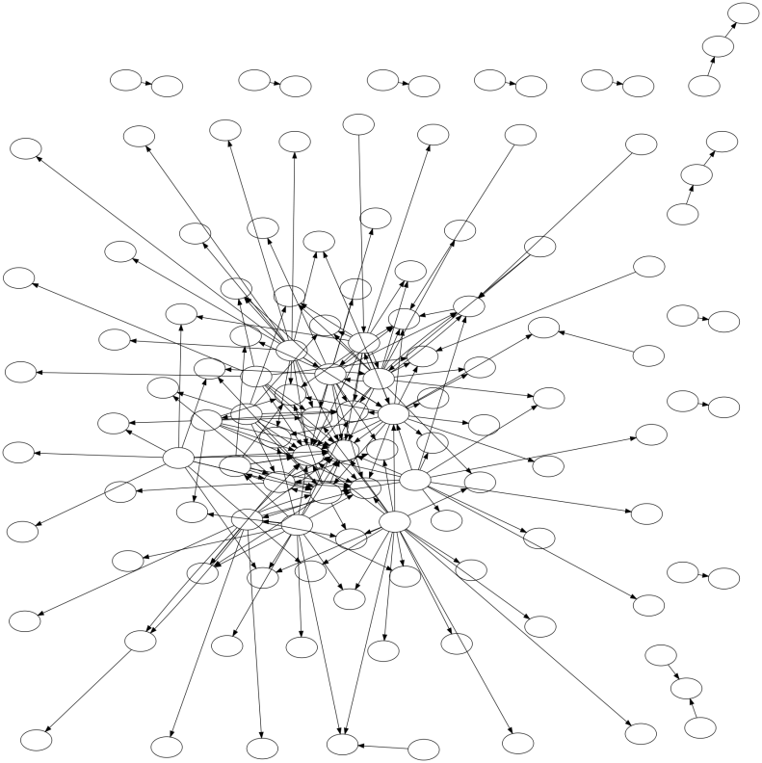
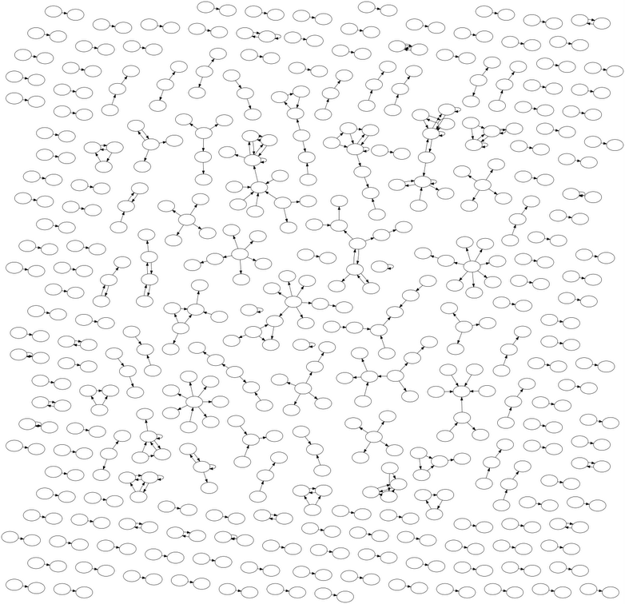
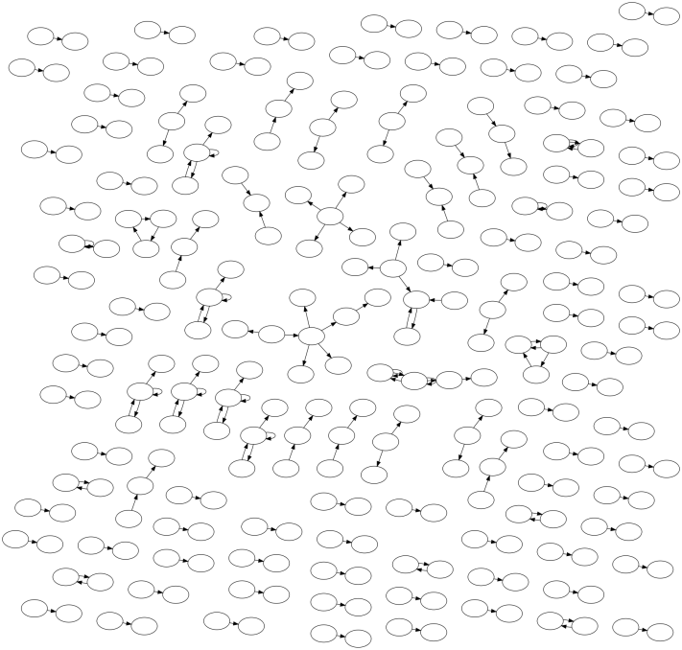
Information Diffusion Related to Real-time Events
Information Flow Networks on Twitter
Nintendo DS Game
an earthquake
a typhoon
In the case of an earthquakes and a typhoons, very little information diffusion takes place on Twitter, compared to Nintendo DS Game
→ We assume that Twitter user sensors are independent about earthquakes and typhoons

Slide 27
Outline
Experiments And Evaluation

Slide 28
Experiments And Evaluation
We demonstrate performances of
  tweet classification
  event detection from time-series data
  → show this results in “application”
  location estimation from a series of spatial information

Slide 29
Evaluation of Semantic Analysis
Queries
  Earthquake query: “shaking” and “earthquake”
  Typhoon query:”typhoon”
Examples to create classifier
  597 positive examples

Slide 30
Evaluation of Semantic Analysis
“earthquake” query
“shaking” query
Features | Recall | Precision | F-Value
Statistical | 87.50% | 63.64% | 73.69%
Keywords | 87.50% | 38.89% | 53.85%
Context | 50.00% | 66.67% | 57.14%
All | 87.50% | 63.64% | 73.69%
Features | Recall | Precision | F-Value
Statistical | 66.67% | 68.57% | 67.61%
Keywords | 86.11% | 57.41% | 68.89%
Context | 52.78% | 86.36% | 68.20%
All | 80.56% | 65.91% | 72.50%
Notes:
The classification performance is presented in these tables.
We obtain highest F-value when we use feature A and all features.
Surprisingly, feature B and feature C don’t contribute much to the classification performance
When an earthquake occurs, a user becomes surprised and might produce a very short tweet.
and It’s apparent that the precision is not so high as the recall.

Slide 31
Discussions of Semantic Analysis
Features | Recall | Precision | F-Value
Statistical | 87.50% | 63.64% | 73.69%
Keywords | 87.50% | 38.89% | 53.85%
Context | 50.00% | 66.67% | 57.14%
All | 87.50% | 63.64% | 73.69%
We obtain highest F-value when we use Statistical features and all features.
Keyword features and Word Context features don’t contribute much to the classification performance
A user becomes surprised and might produce a very short tweet
It’s apparent that the precision is not so high as the recall

Slide 32
Experiments And Evaluation
We demonstrate performances of
  tweet classification
  event detection from time-series data
  → show this results in “application”
  location estimation from a series of spatial information

Slide 33
Evaluation of Spatial Estimation
Target events
  earthquakes
    25 earthquakes from August.2009 to October 2009
  typhoons
    name: Melor
Baseline methods
  weighed average
    simply takes the average of latitudes and longitudes
  the median
    simply takes the median of latitudes and longitudes
We evaluate methods by distances from actual centers
  a distance from an actual center is smaller, a method works better

Slide 34
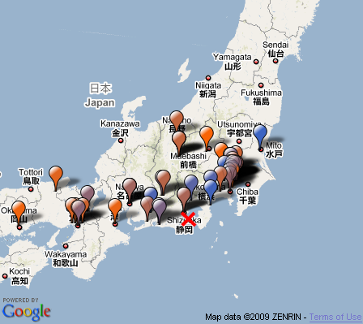
Evaluation of Spatial Estimation
balloon: each tweets
color : post time
Kyoto
Tokyo
estimation
by median
estimation
by particle filter
Osaka
actual earthquake center

Slide 35
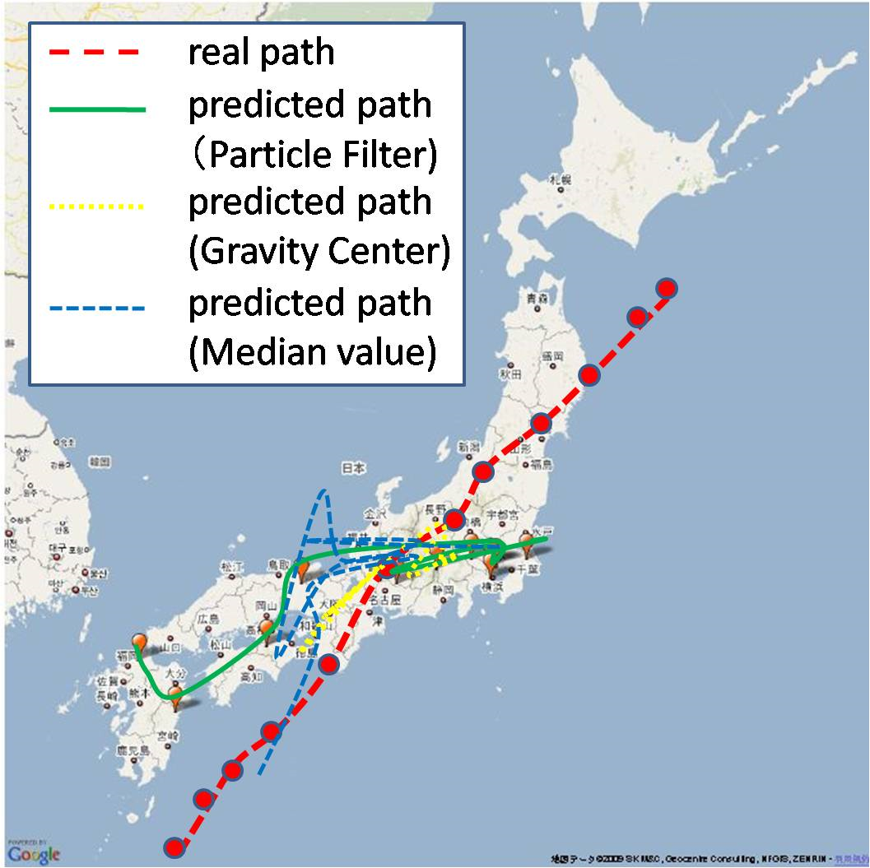
Evaluation of Spatial Estimation

Slide 36
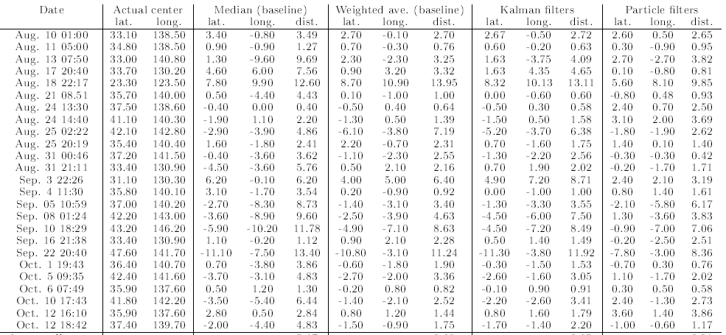
Evaluation of Spatial Estimation
Earthquakes
Date | Actual Center | Median | Weighed Average | Kalman Filter | Particle Filter
mean square errors of latitudes and longitude
Average | － | 5.47 | 3.62 | 3.85 | 3.01
Particle filters works better than other methods

Slide 37
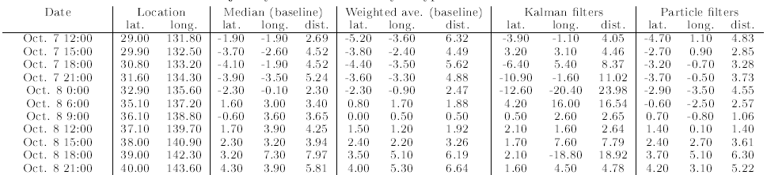
Evaluation of Spatial Estimation
A typhoon
Date | Actual Center | Median | Weighed Average | Kalman Filter | Particle Filter
mean square errors of latitudes and longitude
Average | － | 4.39 | 4.02 | 9.56 | 3.58
Particle Filters works better than other methods

Slide 38
Discussions of Experiments
Particle filters performs better than other methods
If the center of a target event is in an oceanic area, it’s more difficult to locate it precisely from tweets
It becomes more difficult to make good estimation in less populated areas

Slide 39
Outline
Application

Slide 40
Earthquake Reporting System
Toretter ( http://toretter.com)
  Earthquake reporting system using the event detection algorithm
  All users can see the detection of past earthquakes
  Registered users can receive e-mails of earthquake detection reports
Dear Alice,
We have just detected an earthquake
around Chiba. Please take care.
Toretter Alert System

Slide 41
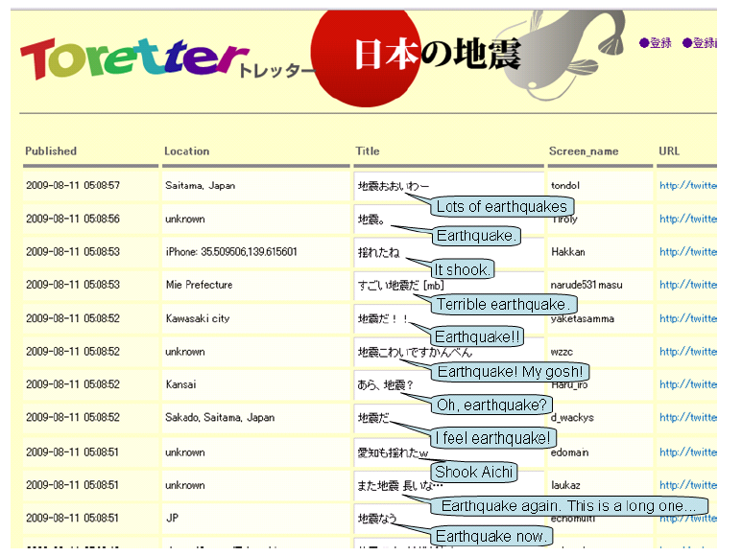
Screenshot of Toretter.com

Slide 42
Earthquake Reporting System
Effectiveness of alerts of this system
  Alert E-mails urges users to prepare for the earthquake if they are received by a user shortly before the earthquake actually arrives.
Is it possible to receive the e-mail before the earthquake actually arrives?
  An earthquake is transmitted through the earth's crust at about 3~7 km/s.
  a person has about 20~30 sec before its arrival at a point that is 100 km distant from an actual center

Slide 43
Results of Earthquake Detection
Date | Magnitude | Location | Time | E-mail sent time | time gap [sec] | # tweets within 10 minutes | Announce of JMA
Aug. 18 | 4.5 | Tochigi | 6:58:55 | 7:00:30 | 95 | 35 | 7:08
Aug. 18 | 3.1 | Suruga-wan | 19:22:48 | 19:23:14 | 26 | 17 | 19:28
Aug. 21 | 4.1 | Chiba | 8:51:16 | 8:51:35 | 19 | 52 | 8:56
Aug. 25 | 4.3 | Uraga-oki | 2:22:49 | 2:23:21 | 31 | 23 | 2:27
Aug.25 | 3.5 | Fukushima | 2:21:15 | 22:22:29 | 73 | 13 | 22:26
Aug. 27 | 3.9 | Wakayama | 17:47:30 | 17:48:11 | 41 | 16 | 1:7:53
Aug. 27 | 2.8 | Suruga-wan | 20:26:23 | 20:26:45 | 22 | 14 | 20:31
Ag. 31 | 4.5 | Fukushima | 00:45:54 | 00:46:24 | 30 | 32 | 00:51
Sep. 2 | 3.3 | Suruga-wan | 13:04:45 | 13:05:04 | 19 | 18 | 13:10
Sep. 2 | 3.6 | Bungo-suido | 17:37:53 | 17:38:27 | 34 | 3 | 17:43
In all cases, we sent E-mails before announces of JMA
In the earliest cases, we can sent E-mails in 19 sec.

Slide 44
Experiments And Evaluation
We demonstrate performances of
  tweet classification
  event detection from time-series data
  → show this results in “application”
  location estimation from a series of spatial information

Slide 45
Results of Earthquake Detection
JMA intensity scale | 2 or more | 3 or more | 4 or more
Num of earthquakes | 78 | 25 | 3
Detected | 70(89.7%) | 24(96.0%) | 3(100.0%)
Promptly detected* | 53(67.9%) | 20(80.0%) | 3(100.0%)
Promptly detected: detected in a minutes
JMA intensity scale: the original scale of earthquakes by Japan Meteorology Agency
Period: Aug.2009 – Sep. 2009
Tweets analyzed : 49,314 tweets
Positive tweets : 6291 tweets by 4218 users
We detected 96% of earthquakes that were stronger than scale 3 or more during the period.

Slide 46
Outline
Conclusions

Slide 47
Conclusions
We investigated the real-time nature of Twitter for event detection
Semantic analyses were applied to tweets classification
We consider each Twitter user as a sensor and set a problem to detect an event based on sensory observations
Location estimation methods such as Kaman filters and particle filters are used to estimate locations of events
We developed an earthquake reporting system, which is a novel approach to notify people promptly of an earthquake event
We plan to expand our system to detect events of various kinds such as rainbows, traffic jam etc.

Slide 48
Thank you for your paying attention and
tweeting on earthquakes.
http://toretter.com
Takeshi Sakaki(@tksakaki)

Slide 50
Temporal Model
the probability of an event occurrence at time t
  the false positive ratio of a sensor
  the probability of all n sensors returning a false alarm
  the probability of event occurrence
  sensors at time 0 → sensors at time t
  the number of sensors at time t
expected wait time to deliver notification
  parameter

