Slide 1
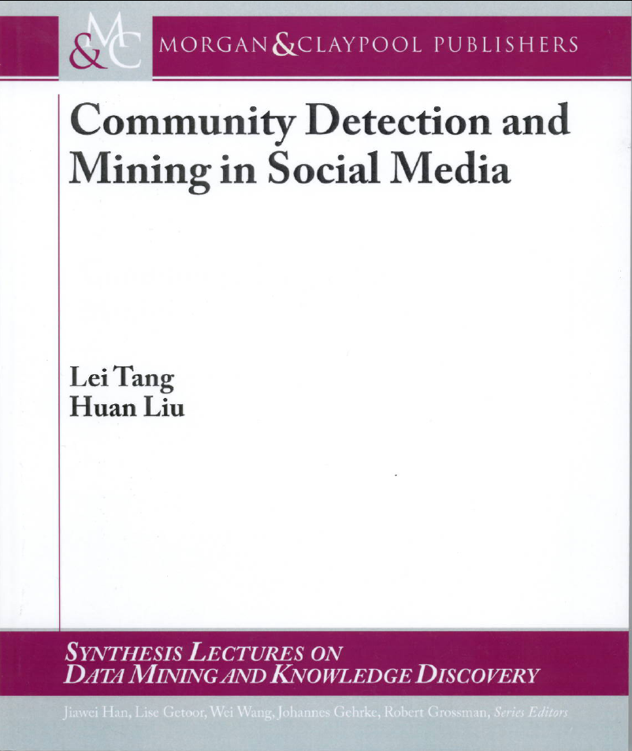
Social Media and Social Computing
Adapted from Chapter 1
Of
Lei Tang and Huan Liu’s Book

Slide 2
Social Media: Many-to-Many
Social Media
Social Networking
Blogs
Microblogging
Wiki
Forum
Content
Sharing
Notes:
There are various of social media: like social network , blogs, wiki, forums content sharing. Most of them are an open platform so users can connect with each other, generate content. These web 2.0 applications gained a lot of online traffic recently. They provide rich information about online users, also new tasks and challenges.

Slide 3
Various forms of Social Media
Blog: Wordpress, blogspot, LiveJournal
Forum: Yahoo! Answers, Epinions
Media Sharing: Flickr, YouTube, Scribd
Microblogging: Twitter, FourSquare
Social Networking: Facebook, LinkedIn, Orkut
Social Bookmarking: Del.icio.us, Diigo
Wikis: Wikipedia, scholarpedia, AskDrWiki

Slide 4
Characteristics of Social Media
“Consumers” become “Producers”
Rich User Interaction
User-Generated Contents
Collaborative environment
Collective Wisdom
Long Tail
Broadcast Media
Filter, then Publish
Social Media
Publish, then Filter

Slide 5
Top 20 Websites at USA
1 | Google.com | 11 | Blogger.com
2 | Facebook.com | 12 | msn.com
3 | Yahoo.com | 13 | Myspace.com
4 | YouTube.com | 14 | Go.com
5 | Amazon.com | 15 | Bing.com
6 | Wikipedia.org | 16 | AOL.com
7 | Craigslist.org | 17 | LinkedIn.com
8 | Twitter.com | 18 | CNN.com
9 | Ebay.com | 19 | Espn.go.com
10 | Live.com | 20 | Wordpress.com
40% of websites are social media sites
Notes:
This is based on the Alex Report as of August 3, 2010

Slide 6
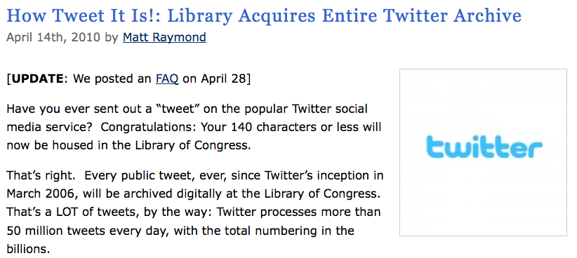

Slide 7
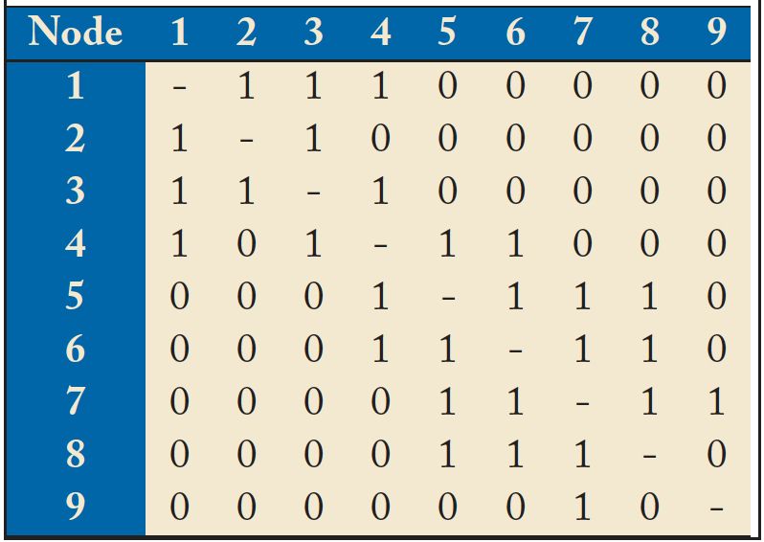
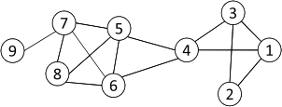
Networks and Representation
Social Network: A social structure made of nodes (individuals or organizations) and edges that connect nodes in various relationships like friendship, kinship etc.
Graph Representation
Matrix Representation

Slide 8
Basic Concepts
A: the adjacency matrix
V: the set of nodes
E: the set of edges
v_{i}: a node v_{i}
e(v_{i}, v_{j}): an edge between node v_{i} and v_{j}
N_{i}: the neighborhood of node v_{i}
d_{i}: the degree of node v_{i}
geodesic: a shortest path between two nodes
geodesic distance

Slide 9
Properties of Large-Scale Networks
Networks in social media are typically huge, involving millions of actors and connections.
Large-scale networks in real world demonstrate similar patterns
Scale-free distributions
Small-world effect
Strong Community Structure

Slide 10
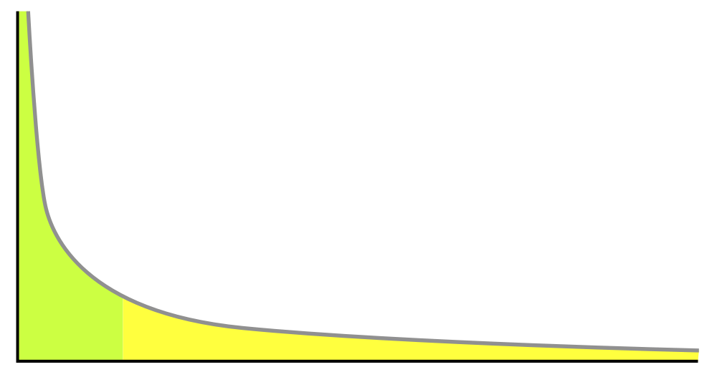
Scale-free Distributions
Degree distribution in large-scale networks often follows a power law.
Nodes
A.k.a. long tail distribution, scale-free distribution
Degrees

Slide 11
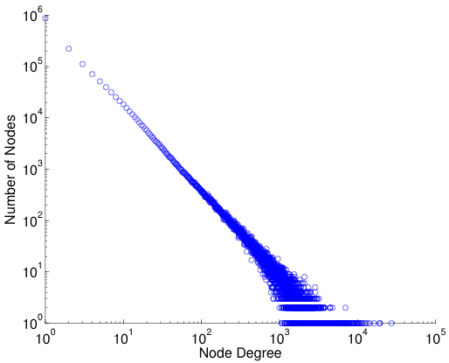
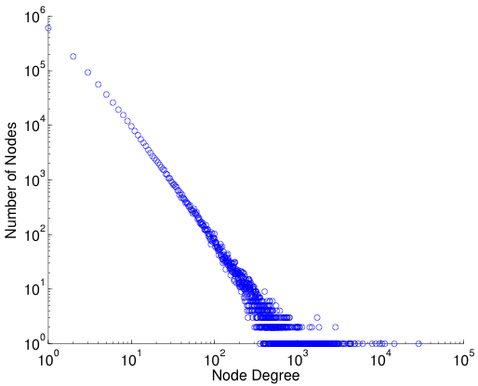
log-log plot
Power law distribution becomes a straight line if plot in a log-log scale
Friendship Network in Flickr
Friendship Network in YouTube

Slide 12
Small-World Effect
“Six Degrees of Separation”
A famous experiment conducted by Travers and Milgram (1969)
Subjects were asked to send a chain letter to his acquaintance in order to reach a target person
The average path length is around 5.5
Verified on a planetary-scale IM network of 180 million users (Leskovec and Horvitz 2008)
The average path length is 6.6

Slide 13
The Milgram Experiment (Wikipedia)
Basic procedure
1. Milgram typically chose individuals in the U.S. cities of Omaha, Nebraska and Wichita, Kansas to be the starting points and Boston, Massachusetts to be the end point of a chain of correspondence,
because they were thought to represent a great distance in the United States, both socially and geographically.
2. Information packets were initially sent to "randomly" selected individuals in Omaha or Wichita. They included letters, which detailed the study's purpose, and basic information about a target contact person in Boston.
It additionally contained a roster on which they could write their own name, as well as business reply cards that were pre-addressed to Harvard.

Slide 14
The Milgram Experiment (cont.)
3. Upon receiving the invitation to participate, the recipient was asked whether he or she personally knew the contact person described in the letter.
If so, the person was to forward the letter directly to that person. For the purposes of this study, knowing someone "personally" was defined as knowing them on a first-name basis.
4. In the more likely case that the person did not personally know the target, then the person was to think of a friend or relative they know personally that is more likely to know the target.
A postcard was also mailed to the researchers at Harvard so that they could track the chain's progression toward the target.
5. When and if the package eventually reached the contact person in Boston, the researchers could examine the roster to count the number of times it had been forwarded from person to person.
Additionally, for packages that never reached the destination, the incoming postcards helped identify the break point in the chain.

Slide 15
Result of the Experiment
However, a significant problem was that often people refused to pass the letter forward, and thus the chain never reached its destination.
In one case, 232 of the 296 letters never reached the destination.[3]
However, 64 of the letters eventually did reach the target contact.
Among these chains, the average path length fell around 5.5 or six.

Slide 16
Diameter
Measures used to calibrate the small world effect
Diameter: the longest shortest path in a network
Average shortest path length
The shortest path between two nodes is called geodesic.
The number of hops in the geodesic is the geodesic distance.
The geodesic distance between node 1 and node 9 is 4.
The diameter of the network is 5, corresponding to the geodesic distance between nodes 2 and 9.

Slide 17
Community Structure
Community: People in a group interact with each other more frequently than those outside the group
ki = number of edges among node Ni’s neighbors
Friends of a friend are likely to be friends as well
Measured by clustering coefficient:
density of connections among one’s friends

Slide 18
Clustering Coefficient
d₆=4, N₆= {4, 5, 7,8}
k₆=4 as e(4,5), e(5,7), e(5,8), e(7,8)
C₆ = 4/(4*3/2) = 2/3
Average clustering coefficient
C = (C₁ + C₂ + … + C_{n})/n
C = 0.61 for the left network
In a random graph, the expected coefficient is 14/(9*8/2) = 0.19.

Slide 19
Challenges
Scalability
Social networks are often in a scale of millions of nodes and connections
Traditional Network Analysis often deals with at most hundreds of subjects
Heterogeneity
Various types of entities and interactions are involved
Evolution
Timeliness is emphasized in social media
Collective Intelligence
How to utilize wisdom of crowds in forms of tags, wikis, reviews
Evaluation
Lack of ground truth, and complete information due to privacy

Slide 20
Social Computing Tasks
Social Computing: a young and vibrant field
Conferences: KDD, WSDM, WWW, ICML, AAAI/IJCAI, SocialCom, etc.
Tasks
Network Modeling
Centrality Analysis and Influence Modeling
Community Detection
Classification and Recommendation
Privacy, Spam and Security

Slide 21
Network Modeling
Large Networks demonstrate statistical patterns:
Small-world effect (e.g., 6 degrees of separation)
Power-law distribution (a.k.a. scale-free distribution)
Community structure (high clustering coefficient)
Model the network dynamics
Reproducing large-scale networks
Examples: random graph, preferential attachment process, Watts and Strogatz model
Simulation to understand network properties
Thomas Shelling’s famous simulation: What could cause the segregation of white and black people
Network robustness under attack
Notes:
He wondered if racial segregation might, in principle, have absolutely nothing to do with racism.
First experiment – racism can cause segregation
Second experiment – racially tolerant people might prefer to avoid being part of extreme minority (< 30%)

Slide 22
Centrality Analysis and Influence Modeling
Centrality Analysis:
Identify the most important actors or edges
E.g. PageRank in Google
Various other criteria
Influence modeling:
How is information diffused?
How does one influence each other?
Related Problems
Viral marketing: word-of-mouth effect
Influence maximization

Slide 23
Community Detection
A community is a set of nodes between which the interactions are (relatively) frequent
A.k.a., group, cluster, cohesive subgroups, modules
Applications: Recommendation based communities, Network Compression, Visualization of a huge network
New lines of research in social media
Community Detection in Heterogeneous Networks
Community Evolution in Dynamic Networks
Scalable Community Detection in Large-Scale Networks

Slide 24
Classification and Recommendation
Common in social media applications
Tag suggestion, Product/Friend/Group Recommendation
Link prediction
Network-Based Classification

Slide 25
Privacy, Spam and Security
Privacy is a big concern in social media
Facebook, Google buzz often appear in debates about privacy
NetFlix Prize Sequel cancelled due to privacy concern
Simple annoymization does not necessarily protect privacy
Spam blog (splog), spam comments, Fake identity, etc., all requires new techniques
As private information is involved, a secure and trustable system is critical
Need to achieve a balance between sharing and privacy

Slide 26
Two Books: Huan Liu and Lei Tang
Book Available at
Morgan & claypool Publishers
Amazon
If you have any comments, please feel free to contact:
Lei Tang, Yahoo! Labs, ltang@yahoo-inc.com
Huan Liu, ASU huanliu@asu.edu

Slide 27
Book 2: available online
Networks, Crowds, and Markets: Reasoning About a Highly Connected World
By David Easley and Jon Kleinberg

