Slide 1
Discovering Culture Patterns
in OkCupid Database
with Word2Vec
FINAL PRESENTATION
Group 14

Slide 2
Previous Work by Lyndon
· In OkCupid, you, as a user, can easily get access to other users’ questionnaire answers and profiles.
· Greated fake OkCupid accounts and use them to automatically scrape information of targeted users. [Dec. 2014]
· Devide the users into 20 gender-country groups.
· Manually selected several most common and culturally-relevant questions.
· Devised a cultural classification system (5ICC), which classifies each gender-country group with 5 indices pertaining to a cultural trait.
· Cluster the gender-country groups using k-means according to their 5ICC values.

Slide 3
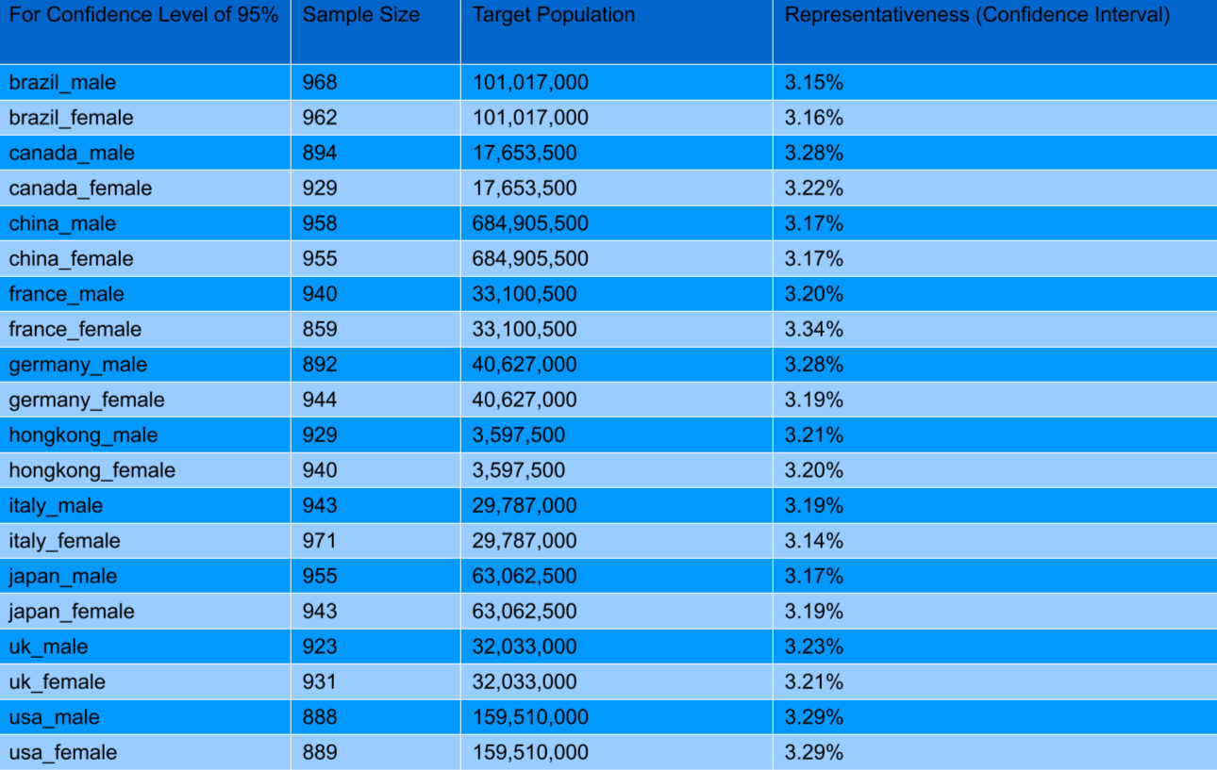
Previous Work by Lyndon
20 gender-country groups:

Slide 4
Previous Work by Lyndon
The 5 indices pertaining to a cultural trait:
· Emotional Openness (EO)
· Intellectual-Ambition (IA)
· Traditional-Communalism (TC)
· Sexual-Romantic Liberalism (SR)
· Substance-Use Liberalism (SU)

Slide 5
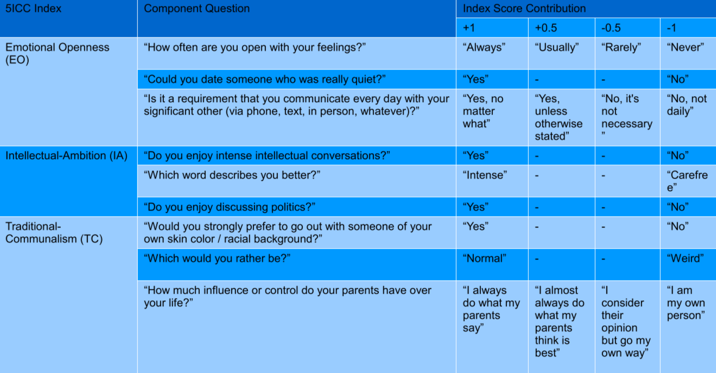
Previous Work by Lyndon
Selected questions pertaining to a cultural trait:

Slide 6
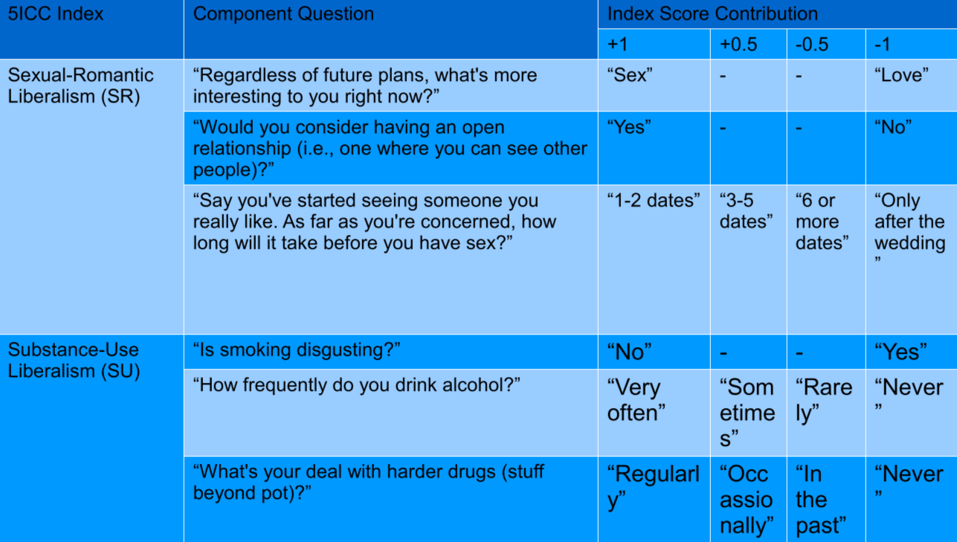
Previous Work by Lyndon
Selected questions pertaining to a cultural trait:

Slide 7
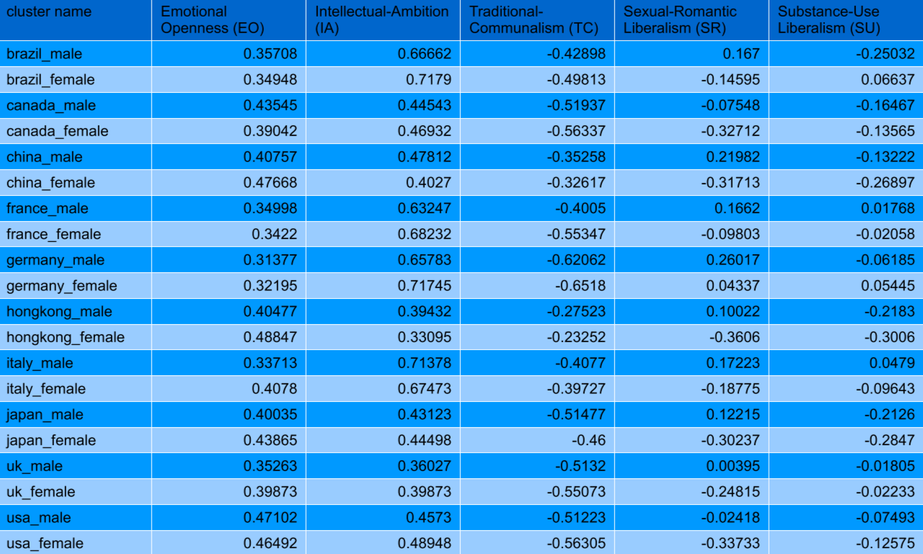
Previous Work by Lyndon
5ICC Scores of each gender-country group:

Slide 8
Previous Work by Lyndon
Lyndon’s result shows there are 7 clusters:
1. brazil_male, china_male, hongkong_male, japan_male
2. canada_female, uk_female, usa_female
3. china_female, hongkong_female, japan_female
4. brazil_female, france_female, Italy_female
5. france_male, italy_male
6. germany_male, germany_femle
7. canada_male, uk_male, usa_male

Slide 9
The weakness in Previous work
Even though the research showed an acceptable result, there are several places to improve:
· The users are simply divided into 20 gender-country groups,which may take the question too easy.
· The question samples are manually selected. 3 questions for each indice in 5ICC might be too few.
· The 5ICC scores are manually given out, which might be subjective.
· For each gender-country group, simply take the average. Average is the simplest way to get estimation of variables, which may lose lot of information.
· Didn’t make use of the users’ personal background (profiles). We may discover a relation between their background and cultural patterns.

Slide 10
Use Word2Vec
to find cultural vector
There are TWO things to decide before using Word2Vec on OkCupid Database: What stands for the WORDs? And what stands for the CONTEXT?
For natural language, the vector is trained with the CONTEXT of the word. Here, we take all the answers to questionnaires that a user has given as the “CONTEXT”.

Slide 11
Use Word2Vec
to find cultural vector
So, we take the different answers to different questionnaires as WORDs.
For example, a man who answers “No” to a question “Do you smoke” would be considered as a WORD “Smoking_No”.
And if he answers “Yes” to a question “Do you like hiking”, it would be considered as a WORD “Hiking_Like”.
So, if we consider this man as a sentence or document, and “Smoking_No” & “Hiking_Like”as WORDs in this sentence.
In this case, “Hiking_Like”would be a CONTEXT of “Smoking_No”.

Slide 12
Use Word2Vec
to find cultural vector
Let’s use 1&2 to denote Smoking_Yes&Smoking_No, and 3&4 to denote Hiking_Like&Hiking_Dislike. So in this way, a user who chooses both Smoking_No and Hiking_Like could be expressed with a “sentence”:
[Smoking_No,Hiking_Like]
Or:
[2,4]
However, this simply binary “word” will absolutely not work.

Slide 13
Use Word2Vec
to find cultural vector
· Binary “Words” Issue
In last example, Smoking_No may have some kinds of connection to Hiking_Yes. However, there are many other cases that two “words” will have no connection at all.(Or at least no direct relation)
Let’s assume that the two words “Smoking_No” & “ScaryMovie_Like” are totally independent. But since they have a very large probability of concurrence, the model will tell that they have a connection, which is absolutely misleading.
Actually, these binary “words” are not words at all. They are just “flags”.

Slide 14
Use Word2Vec
to find cultural vector
· Binary “Words” Issue
There are still ways to create “words”. If single binary “word” doesn’t work, why don’t combine several binary-words together?
Smoking_Yes
Smoking_No
A combined word with more choices
Hiking_Like
Hiking_Dislike

Slide 15
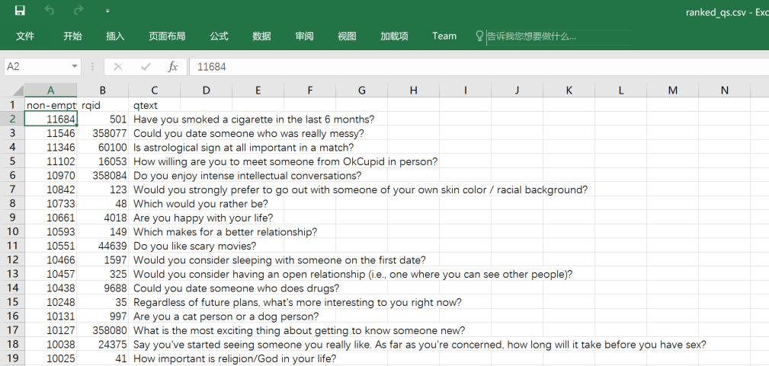
Use Word2Vec
to find cultural vector
There are more than 10 thousand question in OkCupid. Even though many of them are hardly answered by anyone, there are far more than enough questions to train our model on.

Slide 16
Use Word2Vec
to find cultural vector
Let’s take the answers to every 6 questions together as a combined “Word”. The questions are ranked in frequency descending order.
We only take the first 10 words(6*10=60 questions used).
So, for example, a user’s answer could be represented as follow:

Slide 17
Use Word2Vec
to find cultural vector
For each position, there are hundreds of, thousand of possible words. (potentially possible)
It solve the binary word problem.

Slide 18
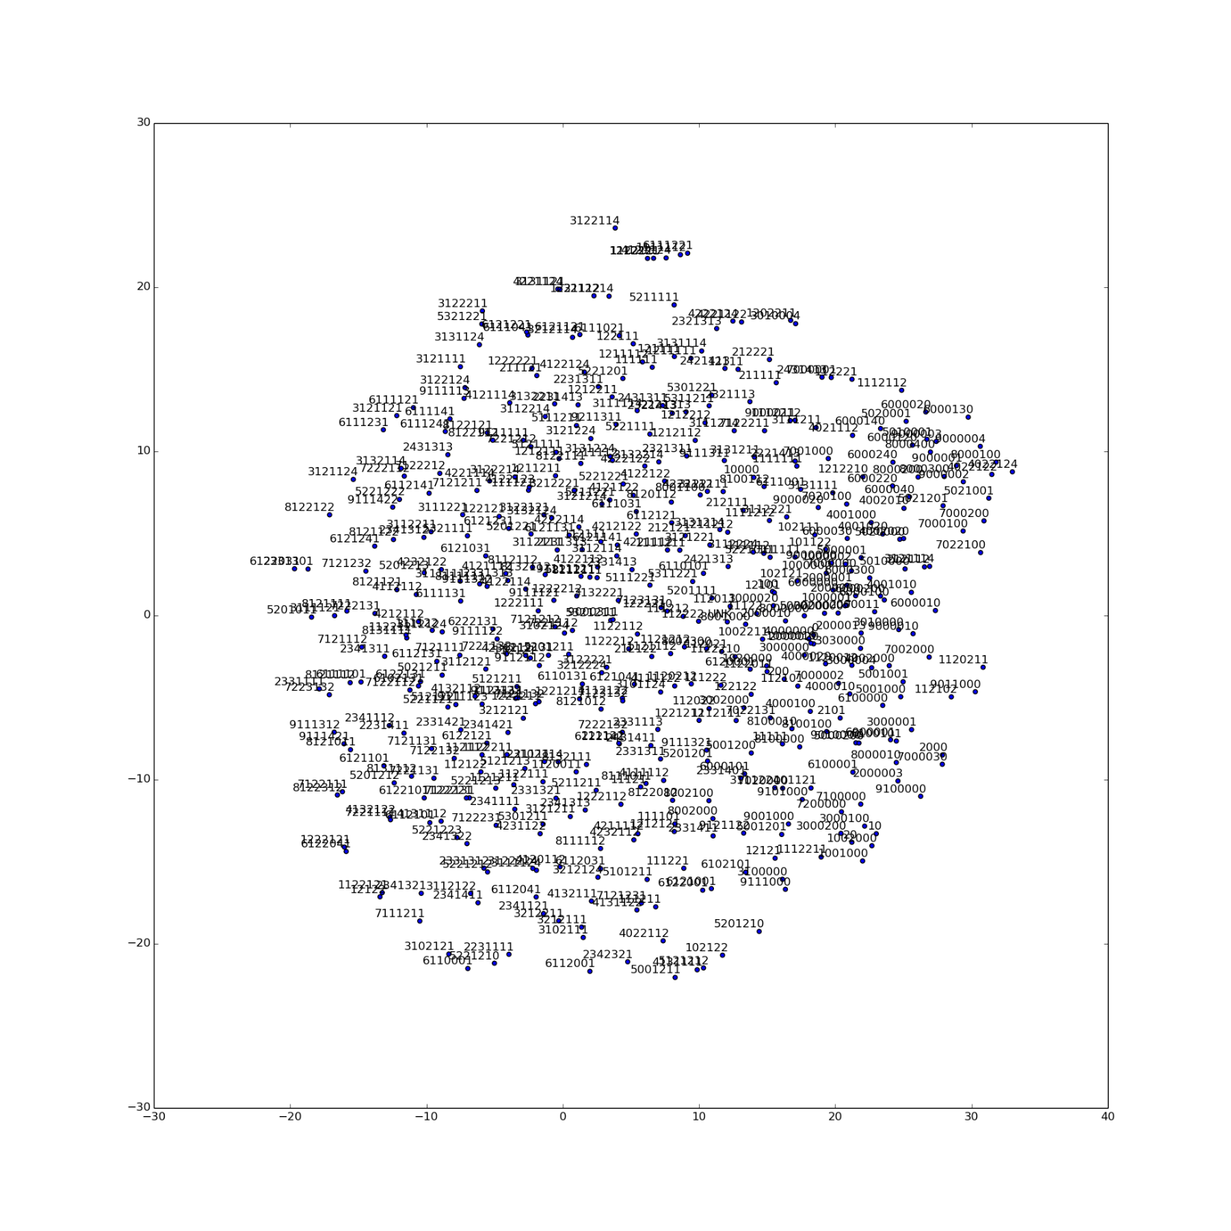
Use Word2Vec
to find cultural vector
Using these defined words to make up the “sentences”, we get our “language model” trained.

Slide 19
Use Word2Vec
to find cultural vector
Using these defined words to make up the “sentences”, we get our “language model” trained.

Slide 20
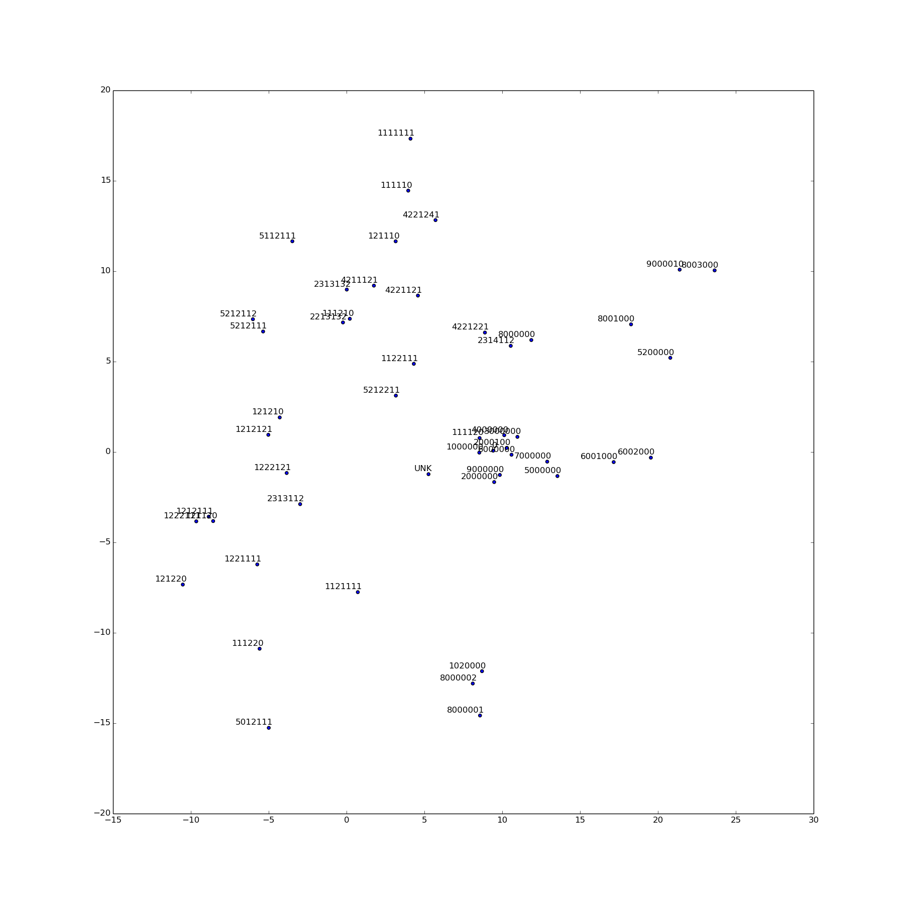
Use Word2Vec
to find cultural vector
Using these defined words to make up the “sentences”, we get our “language model” trained.

Slide 21
Use Word2Vec
to find cultural vector
Using these defined words to make up the “sentences”, we get our “language model” trained.

Slide 22
Use Word2Vec
to find cultural vector
Using these defined words to make up the “sentences”, we get our “language model” trained.

Slide 23
Use Word2Vec
to find cultural vector
By using these WORDs & CONTEXT, we can find the vector representation of the users’ answers to different questions.
By doing Word2Vec, the answers2questions that share a similar meaning would be clustered together.
With WORD vector, we can find a mathematical representation of the whole sentence. With all the “answer vector”, we can have a mathematical representation of the user.
Once we have the numeral representations of users, we can do clustering to them and find the cultural patterns.

Slide 24
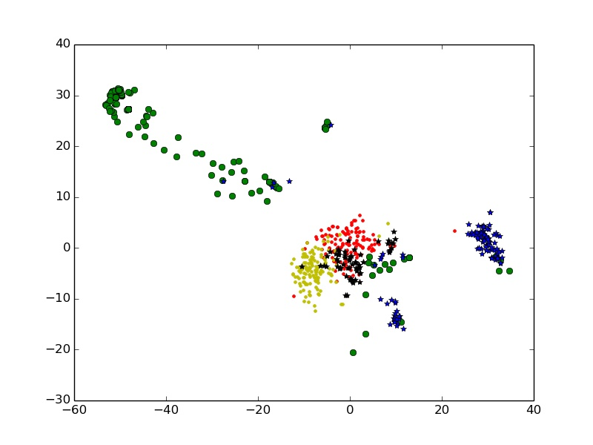
Use Word2Vec
to find cultural vector
I do the sum of the word vectors of every single user, to form a new vector for every user.
Do K-Means to cluster the results. And plot the result in 2-D.
K = 7

Slide 25
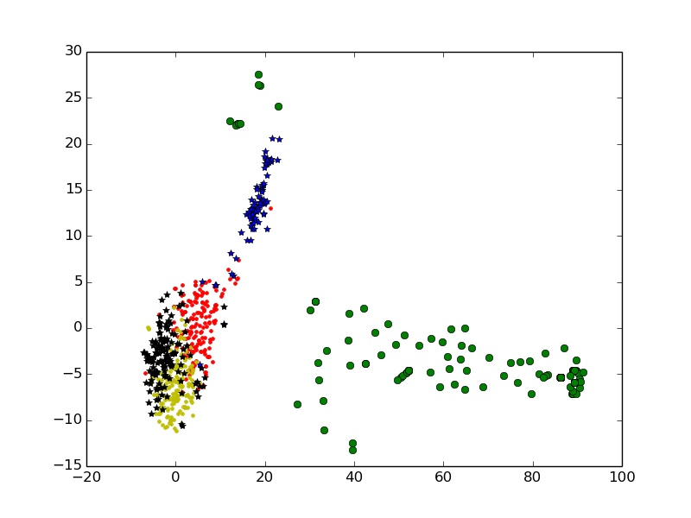
Use Word2Vec
to find cultural vector
I do the sum of the word vectors of every single user, to form a new vector for every user.
Do K-Means to cluster the results. And plot the result in 2-D.
K = 6

Slide 26
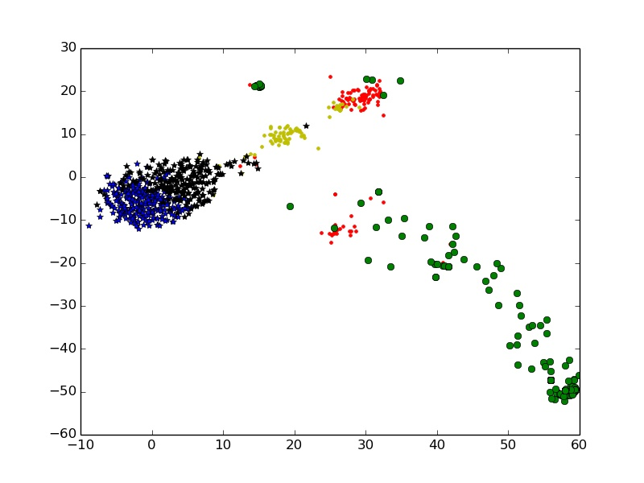
Use Word2Vec
to find cultural vector
I do the sum of the word vectors of every single user, to form a new vector for every user.
Do K-Means to cluster the results. And plot the result in 2-D.
K = 5

Slide 27
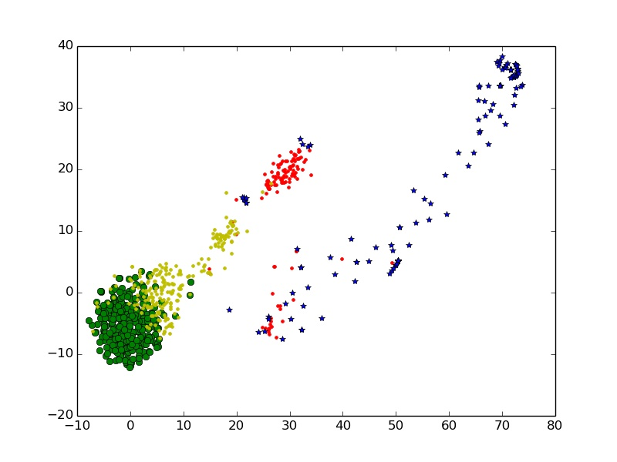
Use Word2Vec
to find cultural vector
I do the sum of the word vectors of every single user, to form a new vector for every user.
Do K-Means to cluster the results. And plot the result in 2-D.
K = 4

Slide 28
What have learned
· Freshman in python -> Mastered
· Freshman in Language Model -> Get a good start
· Get familiar with classic KDD methods
· How to use Tensorflow and Word2Vec
· Some basic knowledge in Computational Social Science

Slide 29
Paper Read
KDD slices
OkCupid Research Progress and Findings Summary Report, by Lyndon Hin-Cheung Chan
Foundations of Statistical Natural Language Processing, by Christopher D. Manning & Hinrich Schutze
A Neural Probabilistic Language Model, by Y Bengio, R Ducharme, P Vincent, C Jauvin
Introduction to Computational Social Science, by Claudio Cioffi-Revilla
Tensorflow Official Website, https://www.tensorflow.org/
Confluence_Conformity Influence in Large Social, by Jie Tang, Sen Wu & Jimeng Sun
A General and Scalable Approach to Mixed Membership Clustering, by Frank Lin, William W. Cohen

