Slide 1
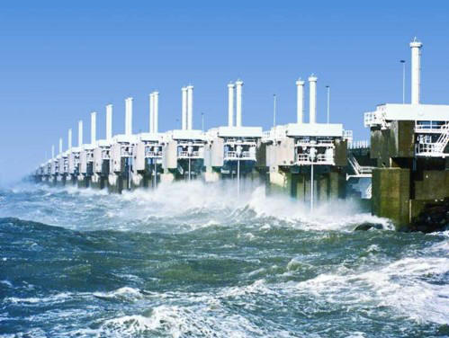
Sharing the Datacenter Network - Seawall
Alan Shieh Cornell University
Srikanth Kandula Albert Greenberg Changhoon Kim Bikas Saha Microsoft Research, Azure, Bing
Presented by WANG Ting

Slide 2
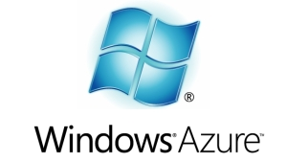
Ability to multiplex is a key driver for the datacenter business
Diverse applications, jobs, and tenants share common infrastructure
The de-facto way to share the network is
Congestion Control at flow granularity (TCP)

Slide 3
Problem: Performance interference
Malicious or Selfish tenant
Normal Traffic
Monopolize shared resource
Use many TCP flows
Use more aggressive variants of TCP
Do not react to congestion (UDP)
Denial of service attack on VM or rack
Place a malicious VM on the same machine (rack) as victim
Flood traffic to that VM

Slide 4
Problem:
Hard to achieve cluster objectives
Even with well-behaved applications, no good way to
Allocate disjoint resources coherently: Reduce slot != Map slot due to differing # of flows
Adapt allocation as needed: Boost task that is holding back job due to congestion

Slide 5
Decouple network allocation from application’s traffic profile
Have freedom to do this in datacenters

Slide 6
Requirements
Provide simple, flexible service interface for tenants
Support any protocol or traffic pattern
Need not specify bandwidth requirements
Scale to datacenter workloads
O(10^5) VMs and tasks, O(10^4) tenants
O(10^5) new tasks per minute, O(10^3) deployments per day
Use network efficiently (e.g., work conserving)
Operate with commodity network devices

Slide 7
Existing mechanisms are insufficient
In-network queuing and rate limiting
Not scalable. Slow, cumbersome to reconfigure switches
End host rate limits
< x Mbps
HV
< x Mbps
HV
Does not provide end-to-end protection; Wasteful in common case
Reservations
Hard to specify. Overhead. Wasteful in common case.

Slide 8
Basic ideas in Seawall
Leverage congestion control loops to adapt network allocation
Utilizes network efficiently
Can control allocations based on policy
Needs no central coordination
Implemented in the hypervisor to enforce policy
Isolated from tenant code
Avoids scalability, churn, and reconfiguration limitations of hardware

Slide 9
Weights: Simple, flexible service model
Every VM is associated with a weight
Seawall allocates bandwidth share in proportion to weight
Weights enable high level policies
Performance isolation
Differentiated provisioning model
Small VM:
CPU = 1 core
Memory = 1 GB
Network weight = 1
Increase priority of stragglers

Slide 10
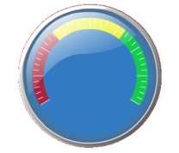
Components of Seawall
Rate controller
Rate controller
Hypervisor
Tunnel
Tunnel
Tunnel
Congestion feedback
(once every 50ms)
To control the network usage of endpoints
Shims on the forwarding paths at the sender and receiver
One tunnel per VM <source,destination>
Periodic congestion feedback (% lost, ECN marked...)
Controller adapts allowed rate on each tunnel

Slide 11
Path-oriented congestion control is not enough
Weight 1
Weight 1

Slide 12
Path-oriented congestion control is not enough
TCP (path-oriented congestion control)
75%
Effective share increases with # of tunnels
Weight 1
25%
Seawall (link-oriented congestion control)
Weight 1
50%
No change in effective weight
50%

Slide 13
Seawall = Link-oriented congestion control
Builds on standard congestion control loops
AIMD, CUBIC, DCTCP, MulTCP, MPAT, ...
Run in rate limit mode
Extend congestion control loops to accept weight parameter
Allocates bandwidth according to per-link weighted fair share
Works on commodity hardware
Will show that the combination achieves our goal

Slide 14
For every source VM
Run a separate distributed control loop (e.g., AIMD) instance for every active link to generate per-link rate limit
Convert per-link rate limits to per-tunnel rate limits
Weight 1
100%
50%
Weight 1
50%

Slide 15
For every source VM
Run a separate distributed control loop (e.g., AIMD) instance for every active link to generate per-link rate limit
Convert per-link rate limits to per-tunnel rate limits
Weight 1
50%
Weight 1
50%

Slide 16
For every source VM
Run a separate distributed control loop (e.g., AIMD) instance for every active link to generate per-link rate limit
Convert per-link rate limits to per-tunnel rate limits
Weight 1
50%
Weight 1
Greedy + exponential smoothing
10%
25%
15%

Slide 17
Achieving link-oriented control loop
How to map paths to links?
Easy to get topology in the data center
Changes are rare and easy to disseminate
How to obtain link-level congestion feedback?
Such feedback requires switch mods that are not yet available
Use path-congestion feedback (e.g., ECN, losses)

Slide 18
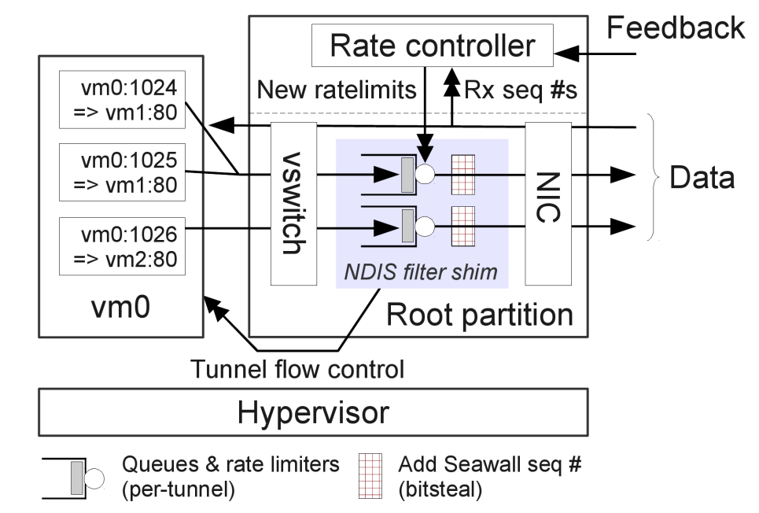
Implementation
Prototype runs on Microsoft Hyper-V root partition and native Windows
Userspace rate controller
Kernel datapath shim (NDIS filter)

Slide 19
Achieving line-rate performance
How to add congestion control header to packets?
Naïve approach: Use encapsulation, but poses problems
More code in shim
Breaks hardware optimizations that depend on header format
Bit-stealing: reuse redundant/predictable parts of existing headers
Other protocols: might need paravirtualization.
# packets
Unused
Seq #
IP | IP-ID
TCP | Timestamp option
 | 0x08 | 0x0a | TSval | TSecr
Constant
Seq #
Notes:
Adding an extra packet header to support Seawall prevents the use of widely-used NIC offloads, and this leads to increased CPU overhead and decreased throughput. To be immediately deployable without performance degradation, Seawall steals bits from existing packet headers, that is, it encodes information in parts of the packet that are unused or predictable and hence can be restored by the shim at the receiver.

Slide 20
Evaluation
Evaluate performance
Examine protection in presence of malicious nodes
Testbed
Xeon L5520 2.26Ghz (4 core Nehalem)
1 Gb/s access links
IaaS model: entities = VMs

Slide 21
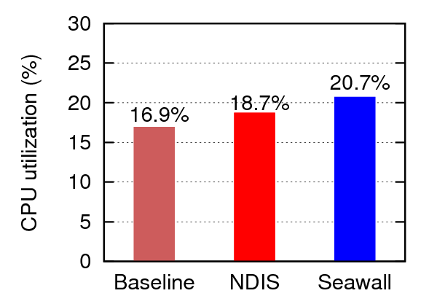
Performance
At Sender
Minimal overhead beyond null NDIS filter (metrics = cpu, memory, throughput)

Slide 22
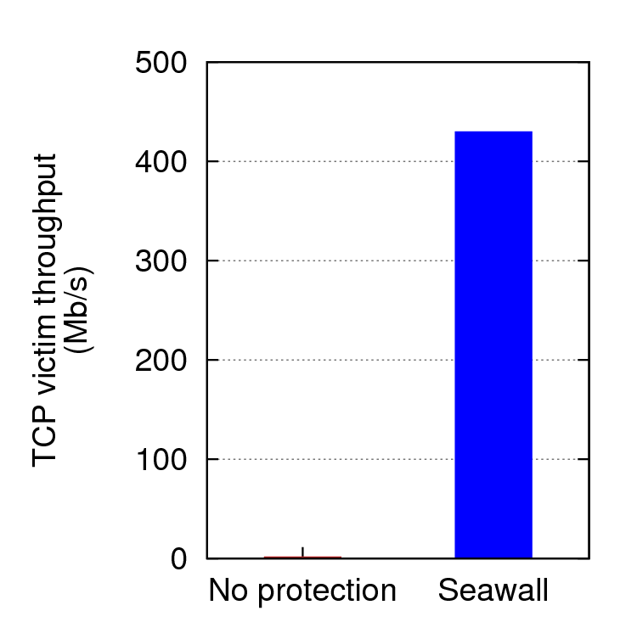
Protection against DoS/selfish traffic
430 Mbps
1000 Mbps
Strategy: UDP flood (red) vs TCP (blue)
Equal weights, so ideal share is 50/50
1.5 Mbps
UDP flood is contained

Slide 23
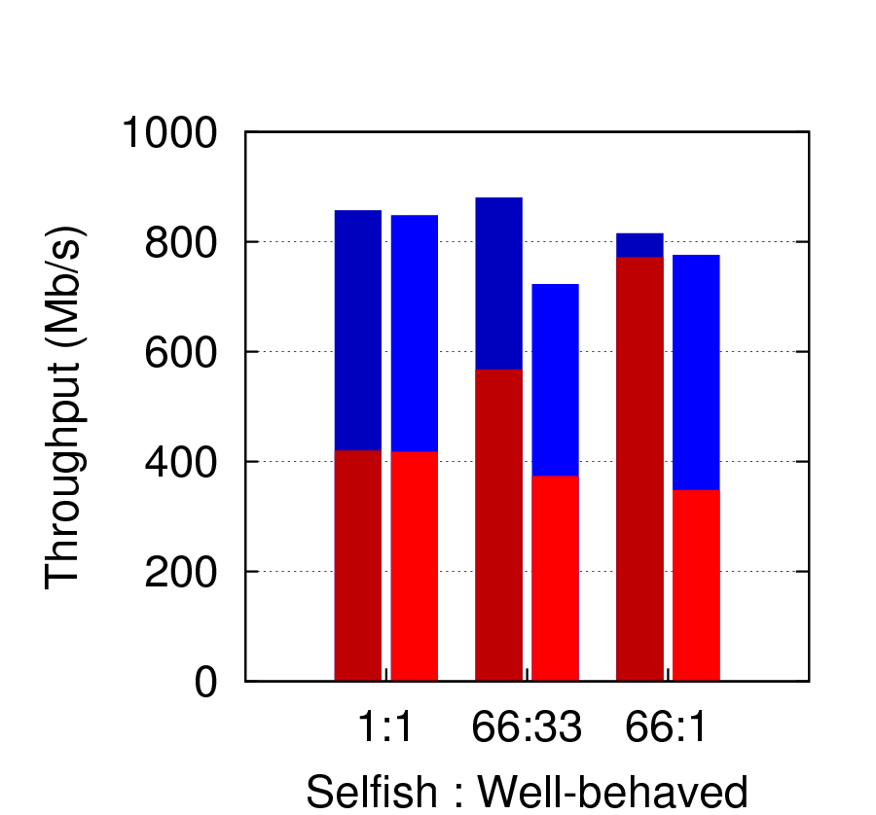
Protection against DoS/selfish traffic
Seawall
Seawall
Seawall
Flow-level: increasing allocation to attacker
Strategy: Open many TCP connections
Attacker sees little increase with # of flows

Slide 24
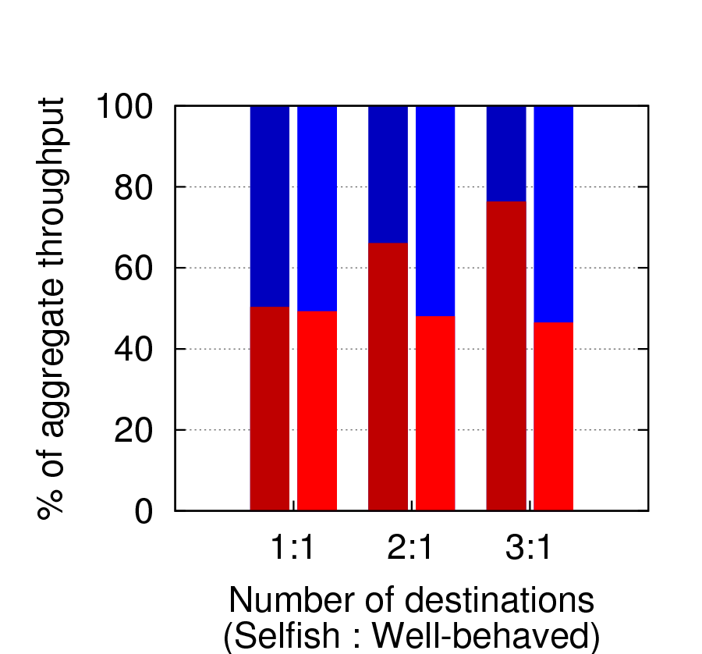
Protection against DoS/selfish traffic
Non-Seawall: increasing allocation to attacker
Seawall
Seawall
Seawall
Strategy: Open connections to many destinations
Allocation see little change with # of destinations

Slide 25
Related work
(Datacenter) Transport protocols
DCTCP, ICTCP, XCP, CUBIC
Network sharing systems
SecondNet, Gatekeeper, CloudPolice
NIC- and switch- based allocation mechanisms
WFQ, DRR, MPLS, VLANs
Industry efforts to improve network / vswitch integration
Congestion Manager

Slide 26
Conclusion
Shared datacenter network are vulnerable to selfish, compromised & malicious tenants
Seawall uses hypervisor rate limiters + end-to-end rate controller to provide performance isolation while achieving high performance and efficient network utilization
We develop link-oriented congestion control
Use parameterized control loops
Compose congestion feedback from many destinations

Slide 27
Thank You!

